Slide 1





Some Effects of DC’s Universal 3 & 4-Year-Old Pre-K Program on Income & Implications for Potential Policy Expansion
Summer Intern Presentation Series #4…
Is it an example of the double dividend?
by Hyungjun Park

Slide 2

■ Table of Contents
Introduction
Methodology
Results
Conclusion and Limitations on Pre-K 3-4
Comments on Pre-K Expansion

Slide 3
Universal Pre-K
■ Introduction
What is the universal Pre-K? Brief Introduction

Slide 4
■ Universal Pre-K in DC
Pre-Kindergarten (PK3 and PK4)
DCPS places a strong value on early childhood education
However, students are not required by law to attend preschool (PK3) or prekindergarten (PK4), the “right to attend” is not extended to children in these grades.
DCPS offers … seats for 3-year-old children in PK3 and seats for 4-year-old children in PK4.
But the capacity is not yet at 100% → My School DC lottery takes applications.

Slide 5

Source: District of Columbia Office of the State Superintendent of Education The State of Pre-K in the District of Columbia 2015 Pre-K Report
■ Universal Pre-K in DC : Summary Statistics
 | Census | # Enrolled | % Served
3 year olds | 8,714 | 5,657 | 65%
4 year olds | 7,695 | 6,955 | 90%
Total | 16,409 | 12,612 | 77%
District-Wide Enrolled Pre-K Children
 | Count | Percentage
Gender
Male | 6,338 | 49%
Female | 6,572 | 51%
Race/Ethnicity
Black | 8,866 | 69%
Hispanic/Latino | 1,824 | 14%
White | 1,701 | 13%
Multiracial | 314 | 2%
Asian | 171 | 1%
Native American | 21 | 0.2%
Pacific Islander | 13 | 0.1%
 | Total Sites | Enrollment | Estimated Capacity | Estimated Utilization
Ward 1 | 16 | 1,240 | 1,320 | 94%
Ward 2 | 6 | 301 | 322 | 93%
Ward 3 | 8 | 383 | 378 | 101%
Ward 4 | 24 | 1,853 | 2,014 | 92%
Ward 5 | 28 | 2,270 | 2,768 | 82%
Ward 6 | 23 | 1,936 | 2,252 | 86%
Ward 7 | 18 | 1,816 | 2,030 | 89%
Ward 8 | 30 | 2,813 | 2,896 | 97%
Total | 153 | 12,612 | 13,980 | 90%

Slide 6
■ Universal Pre-K in Other States
Who Offers Universal Pre-K?
Currently, 39 states other than the District of Columbia offer some form of voluntary Pre-K, but NOT every child is eligible.
In order to be considered universal Pre-K, the program must be offered to all children, no matter the circumstances.
Florida, Georgia, and Oklahoma are the only states that offer Universal Pre-K for all 4-year-old children other than DC.

Slide 7
■ Universal Pre-K : Debates
On maternal labor force participation
Extensive Margin : how many people work?
Intensive Margin : how much do people work on average?
Other Dimensions…
Cost-Benefit Analysis : from the revenue perspective
Child’s Development
: Does universal Pre-K provide better quality education?
: Does Pre-K enhance cognitive and non-cognitive skills?
: Does early development lead to better job market outcomes?

Slide 8
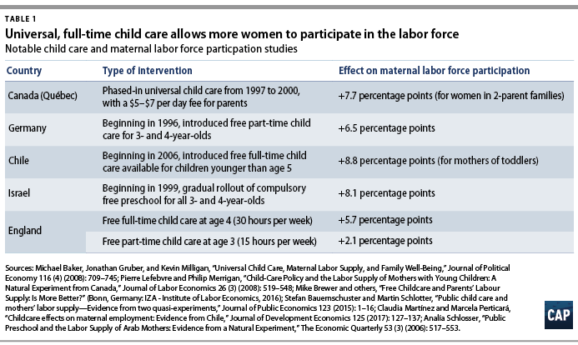
■ Universal Pre-K in Other Countries

Slide 9
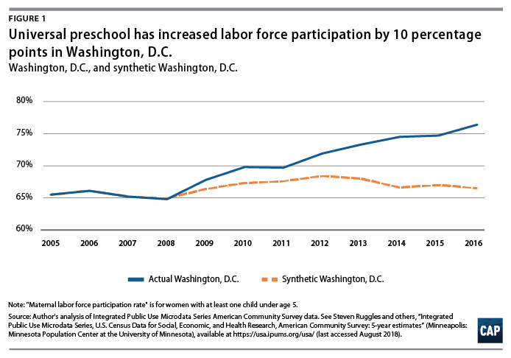
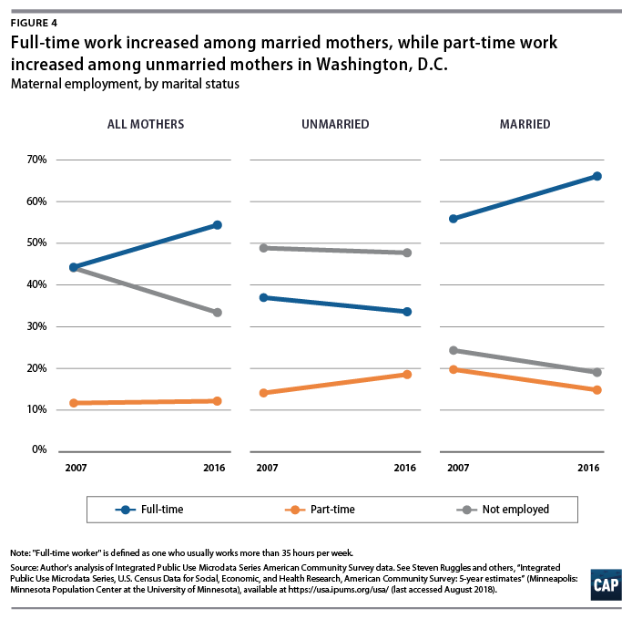
■ Universal Pre-K in DC : Existing Studies

Slide 10
■ Universal Pre-K in DC : Hypothesis
Question Does universal Pre-K implemented in DC affect the mean wage level of the eligible tax filers?
Hypothesis We would expect the universal Pre-K to 1. induce the filers to enroll in Pre-K facilities 2. having enrolled in the Pre-K provides the filers with child-free time 3. thus, the filers now have an option to participate in the labor force 4. if they rejoin the labor force, the participating filers’ income should grow faster than its counterpart

Slide 11
Data Cleaning
■ Methodology
Data cleaning procedures and the models for anlaysis

Slide 12
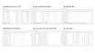
■ Data Source
Original Data Source : Income Tax Data
Main : DC geocoded IIT - all dependent and important independent variables
Supplement : Federal IIT - additional controls (dob of the filer and the child, age of the filer)
Date of Birth and Census Tract restoration - data interpolation
5-year panel structure (balanced, tracking individuals)

Slide 13
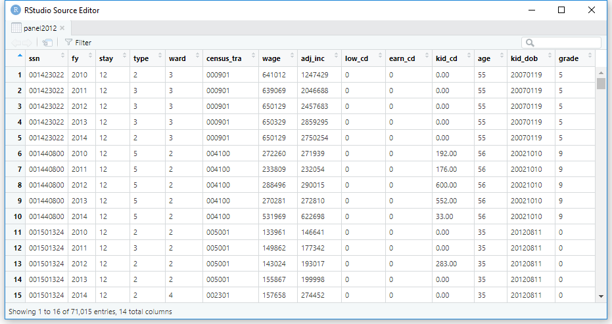
■ 5-Year Panel Structure

Slide 14
■ Model
Difference-in-Differences Wage = Policy + Post + Age + Age^2 + Policy*Post OLS
Interest: the slope difference between the control and the treatment
Pros: do not need to adjust for fluctuations (e.g. inflation…)

Slide 15
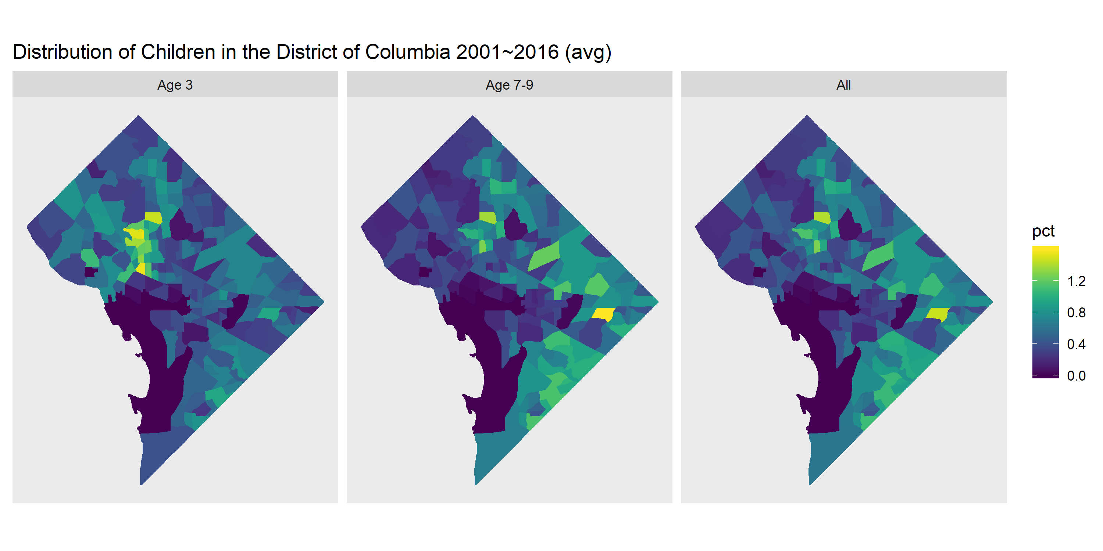
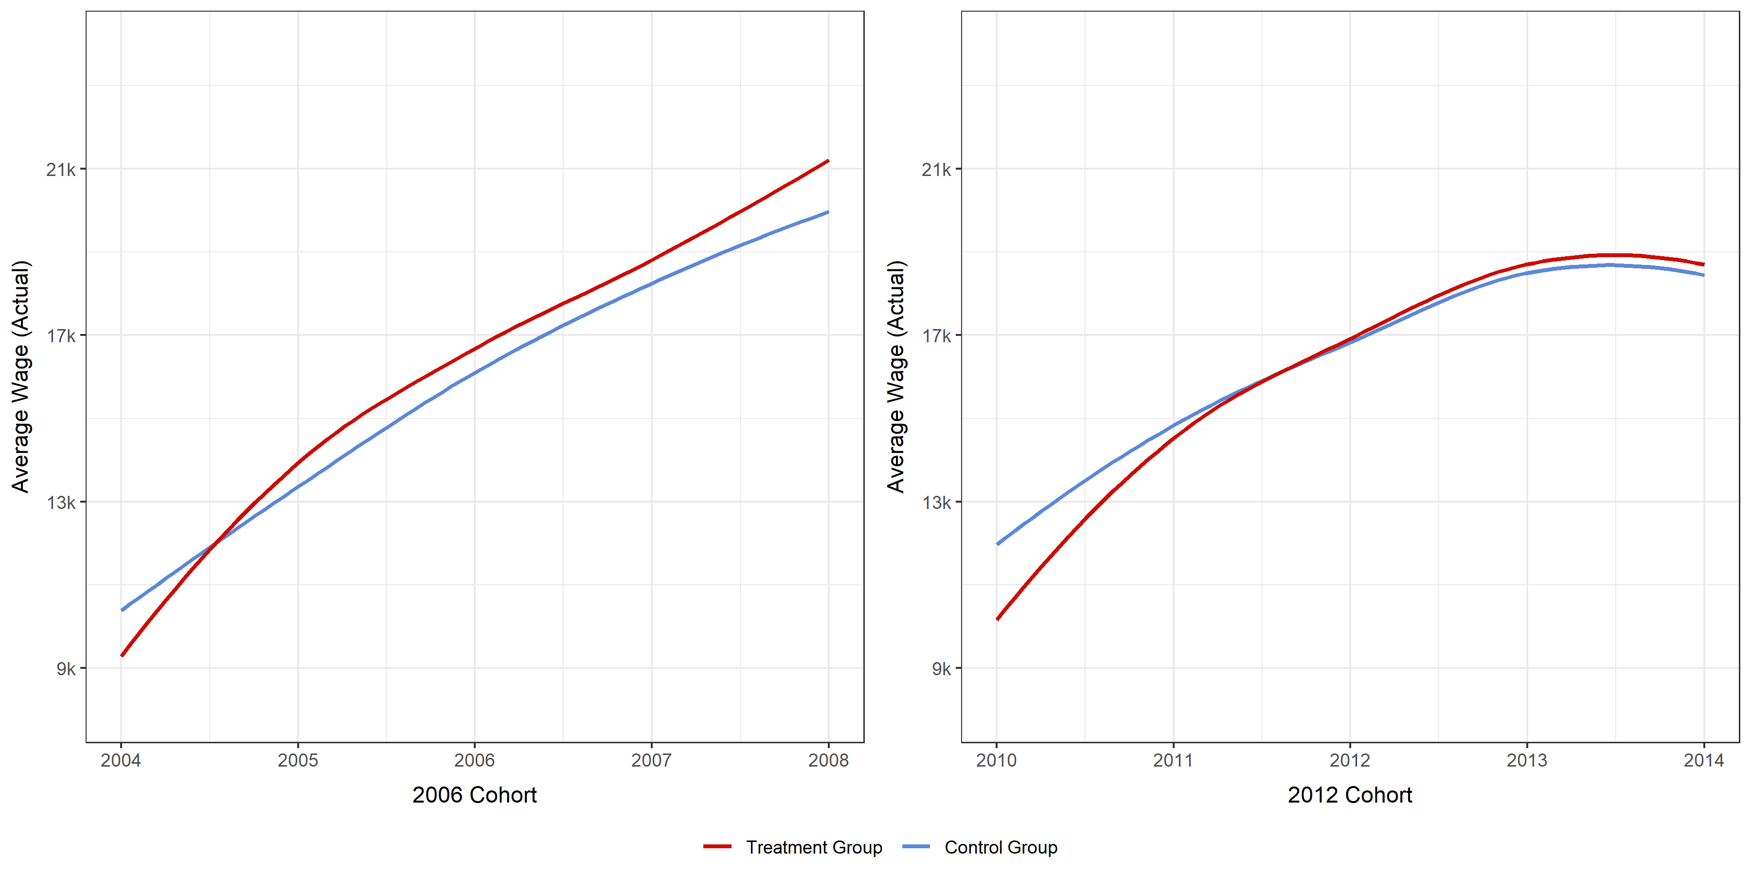
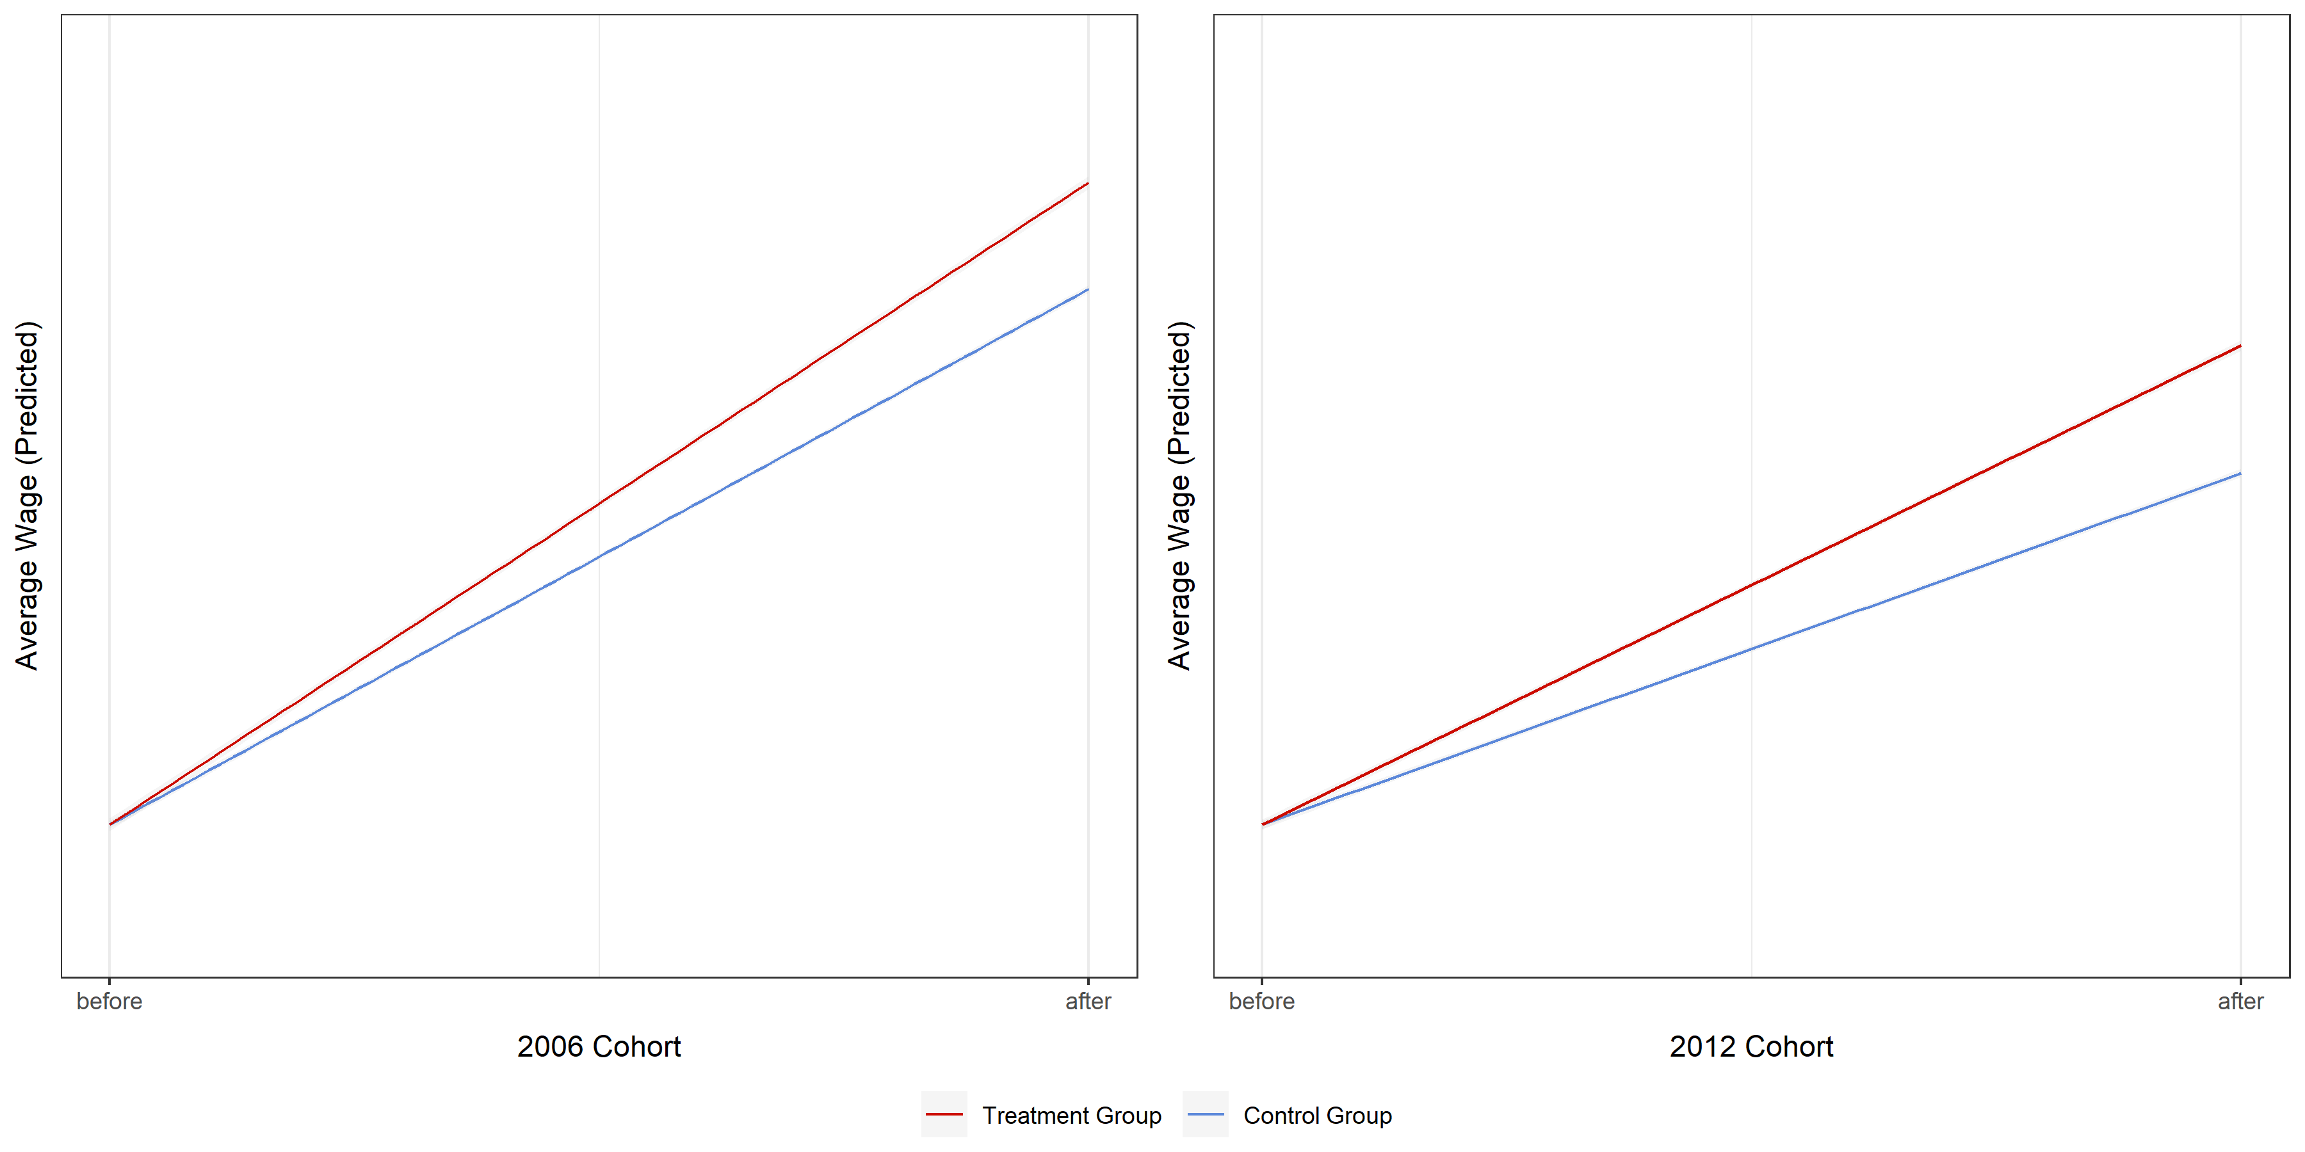
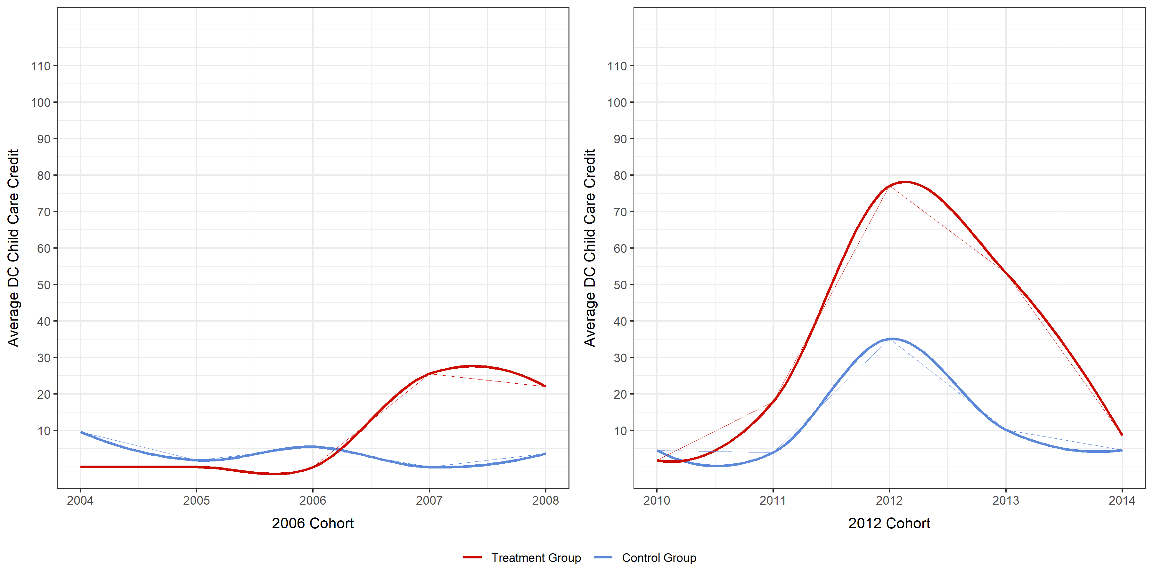
■ Results (example)
Filter
Example
■ Population Distribution
■ Average Wage Trend
Example
RED : Treatment BLUE : Control
■ DiD Regression Plot
■ Childcare Credit (Claimed) Trend

Slide 16
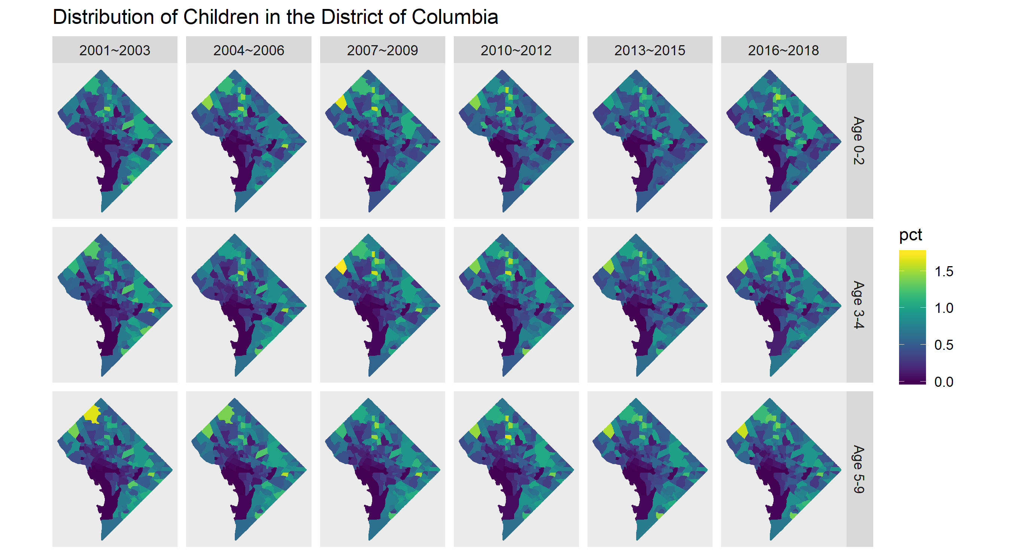
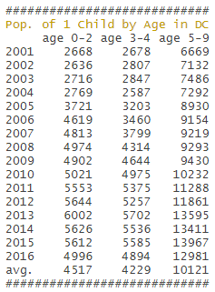
■ Population Trends : Demographics of Filers with a Single Child
Filter
NONE

Slide 17
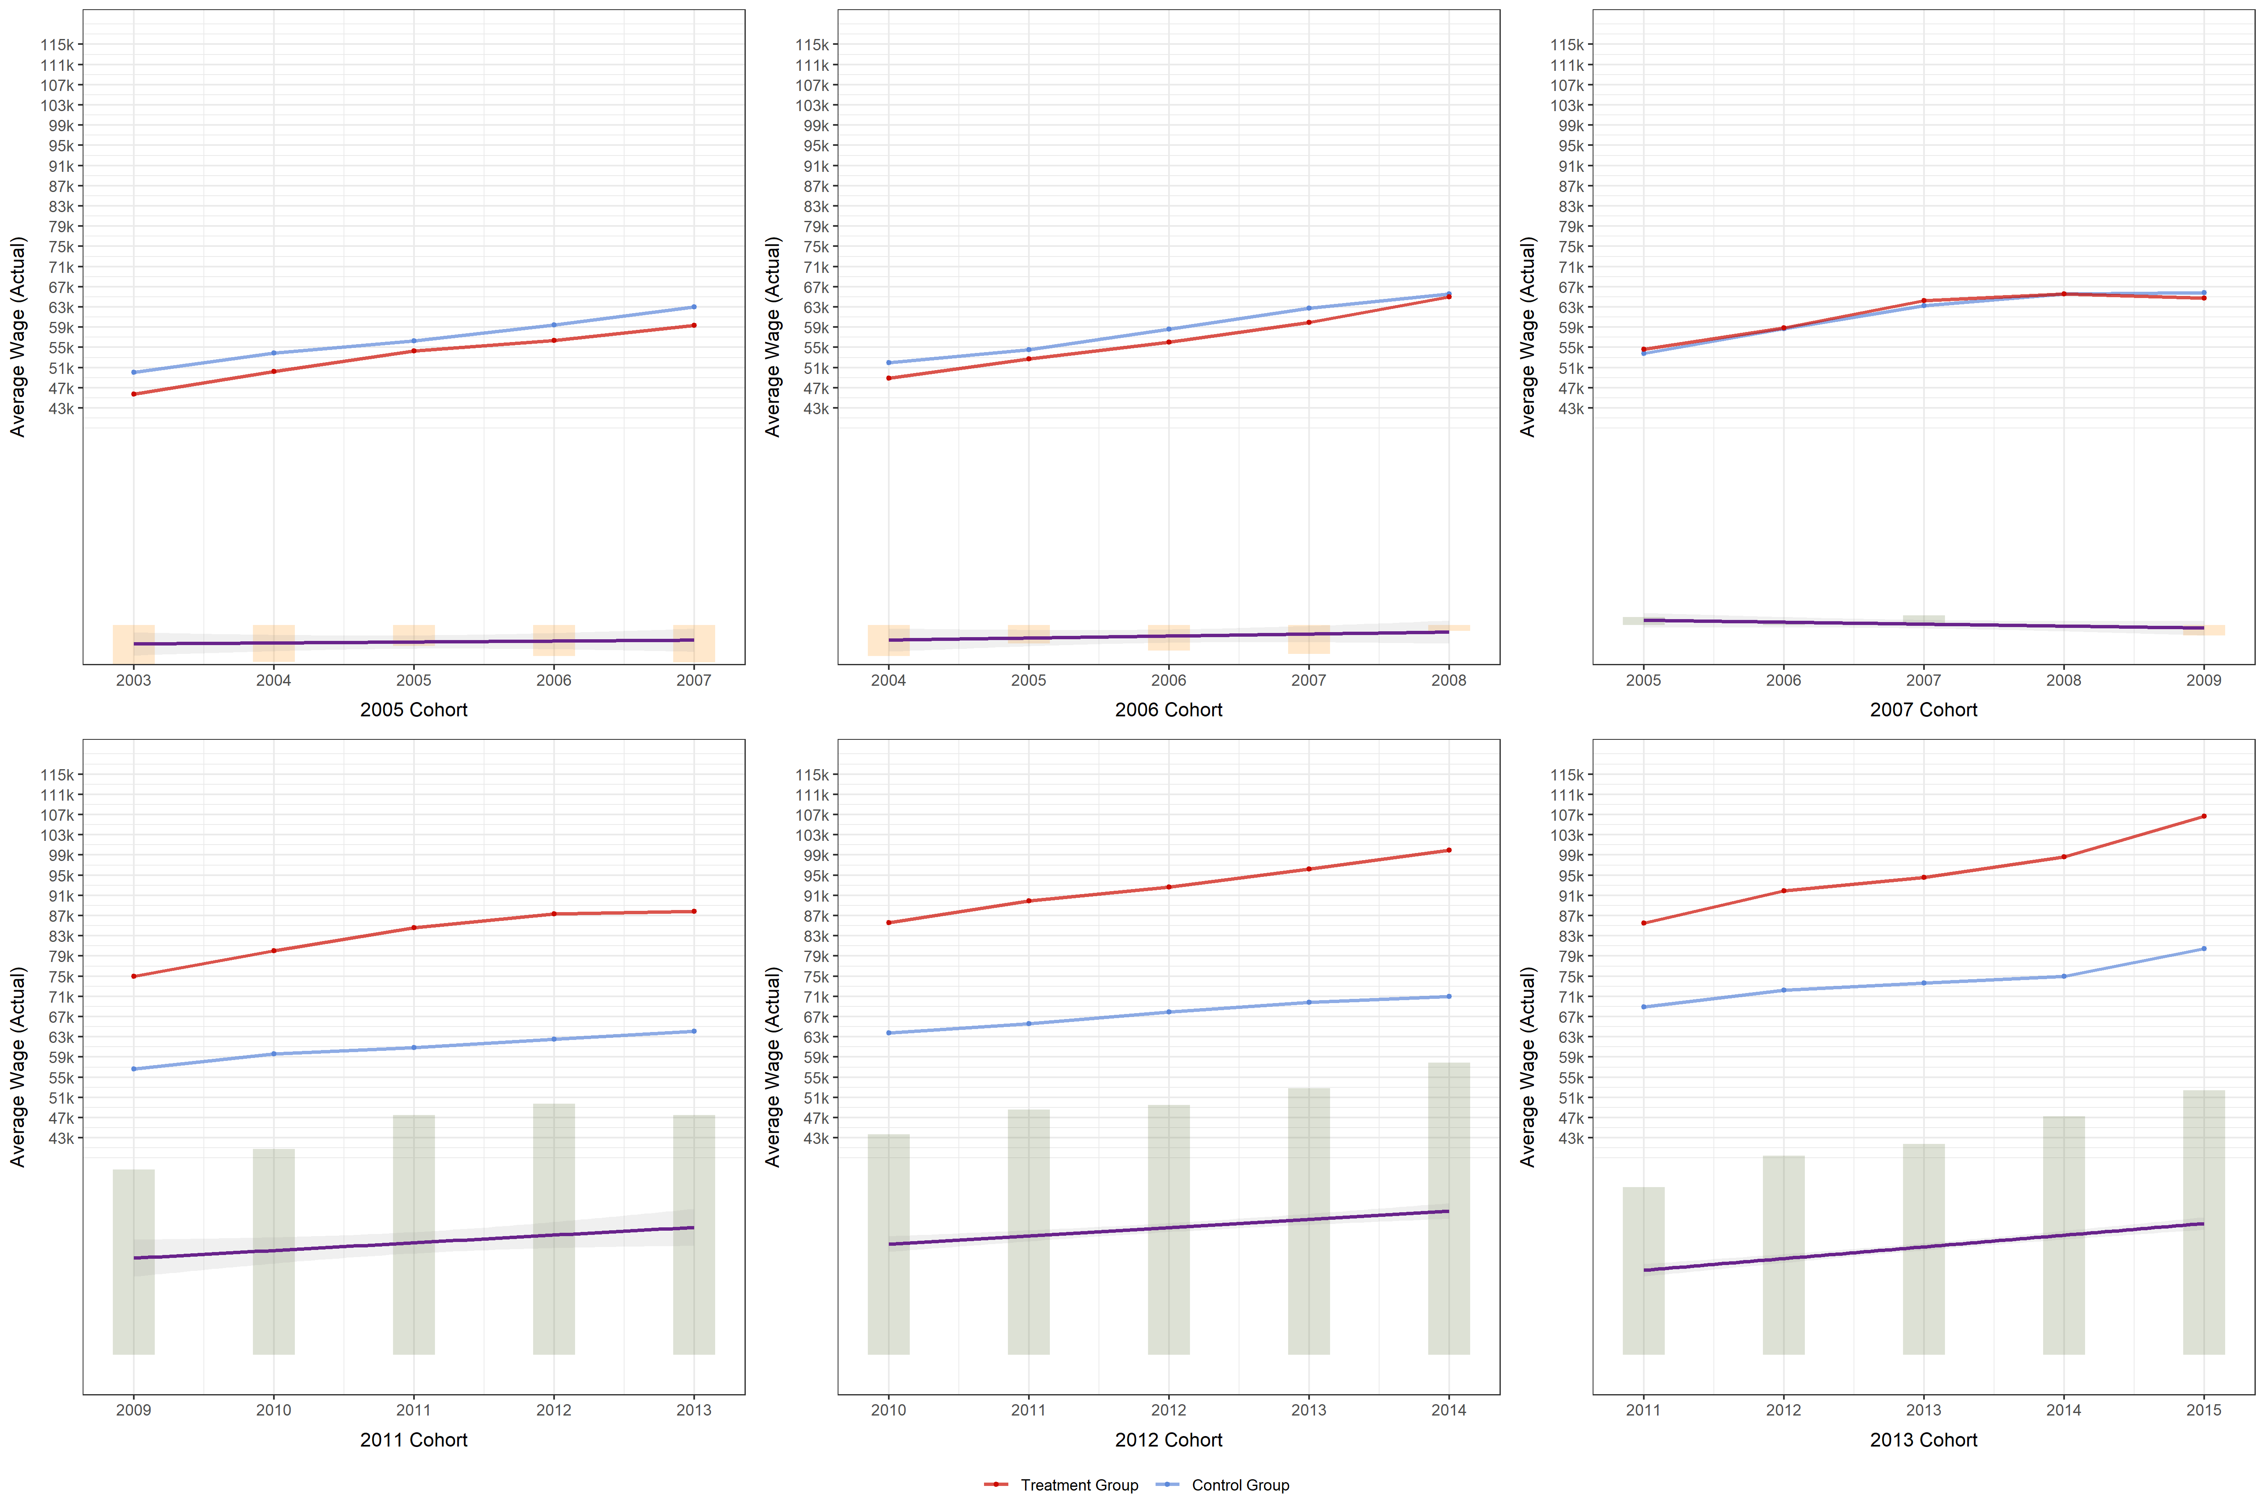
■ Wage Trends (Actual Level)
Filter
NONE
Cohort | Treatment | Control
2005 | 860 | 3,179
2006 | 829 | 3,322
2007 | 1,055 | 4,025
Cohort | Treatment | Control
2011 | 1,511 | 3,768
2012 | 1,390 | 3,835
2013 | 1,459 | 4,143

Slide 18
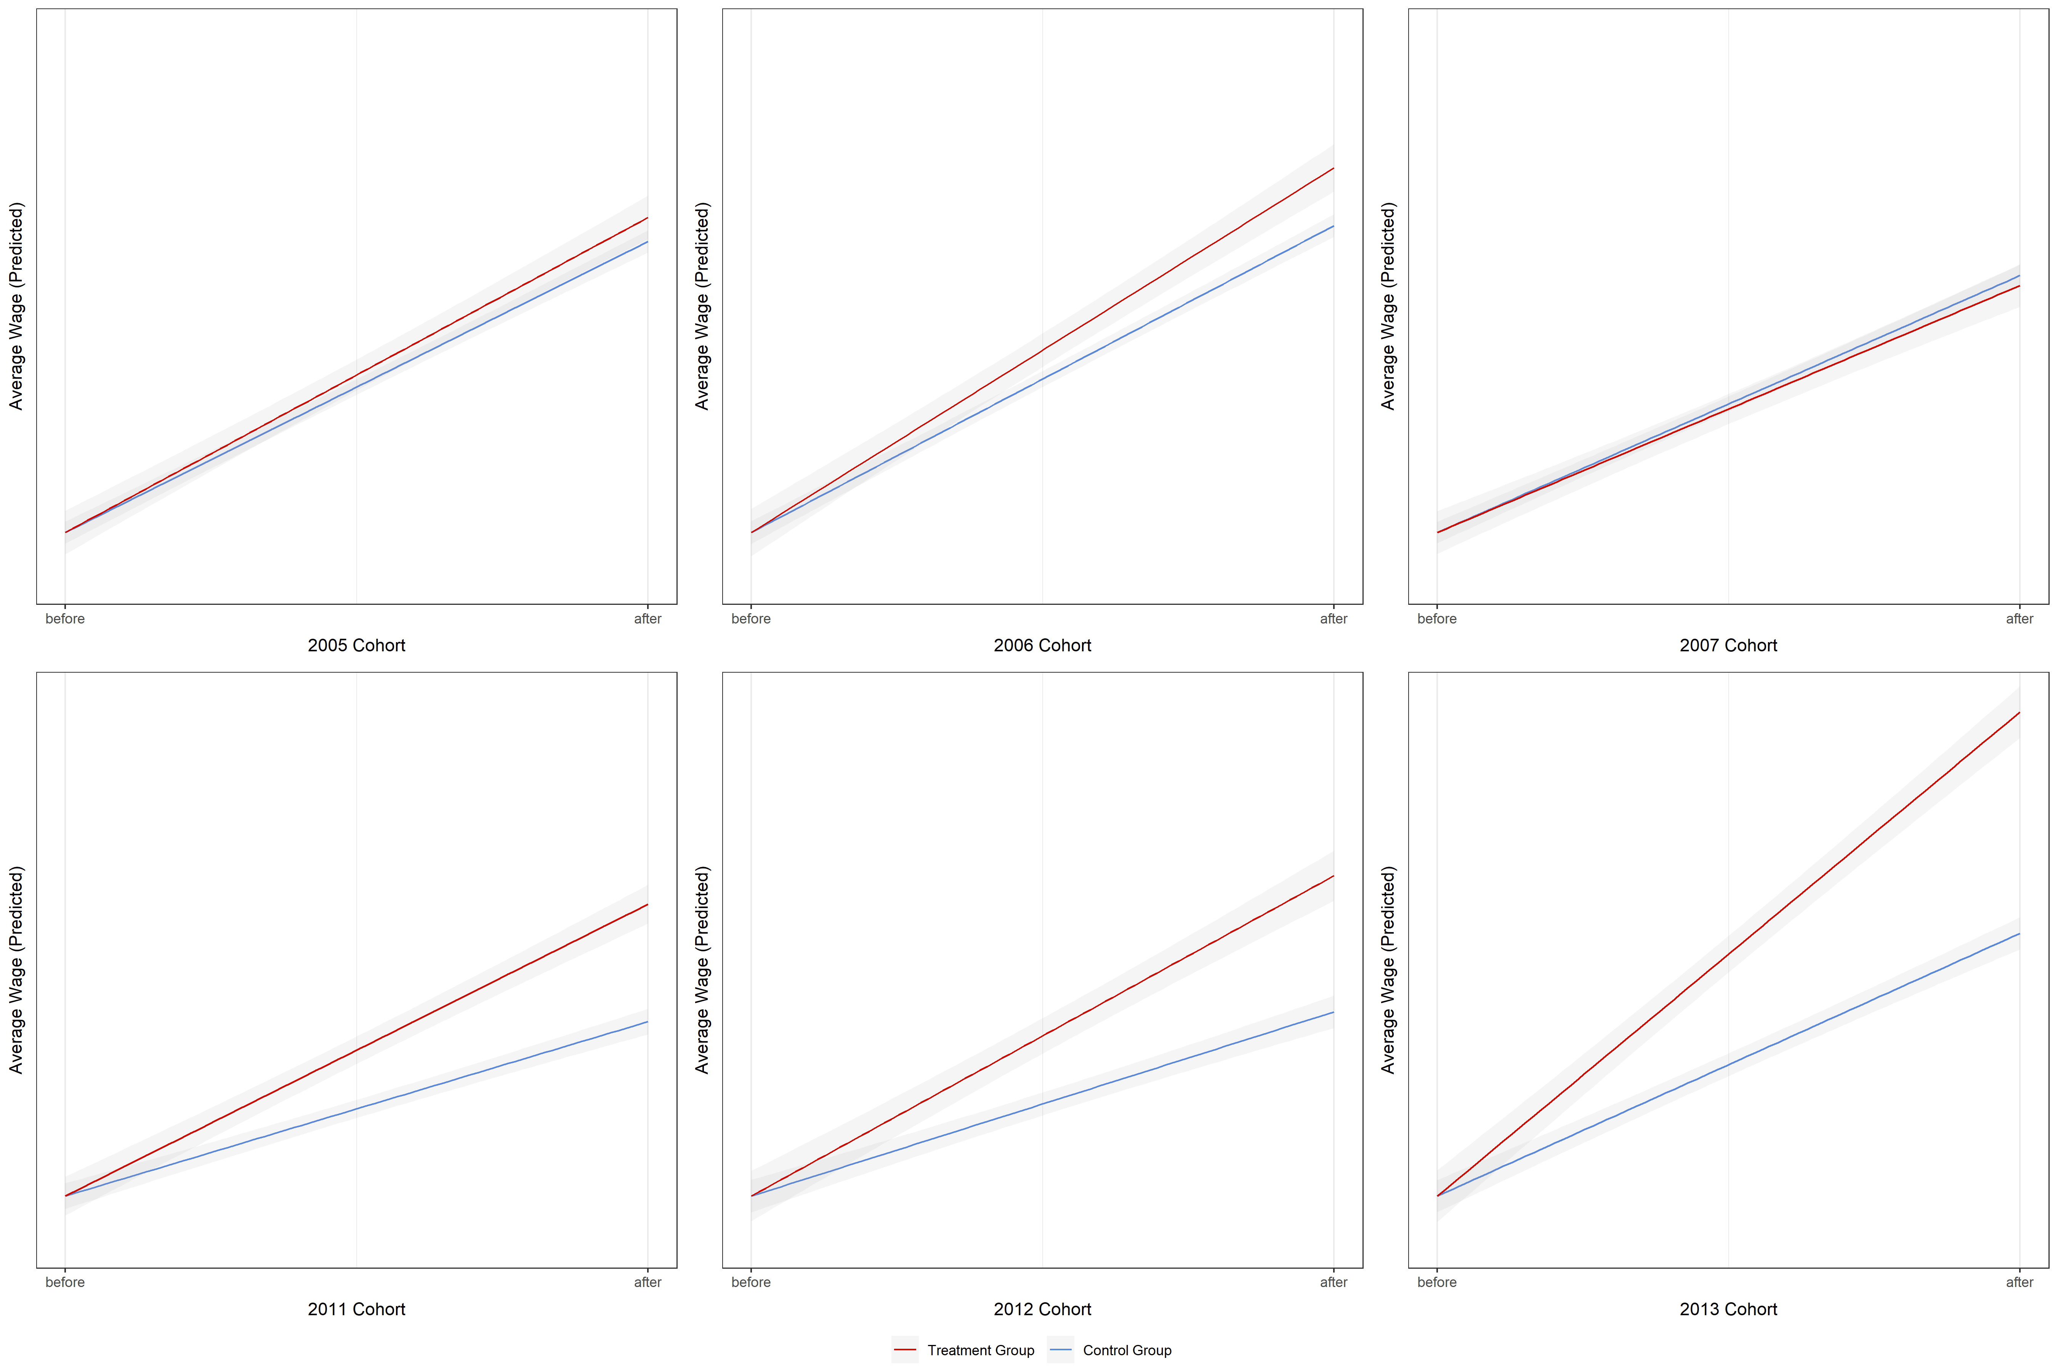
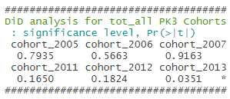
■ DiD Regression (Predicted Level)
Filter
NONE
Cohort | Treatment | Control
2005 | 851 | 3,139
2006 | 816 | 3,282
2007 | 1,033 | 3,946
Cohort | Treatment | Control
2011 | 1,500 | 3,737
2012 | 1,329 | 3,686
2013 | 1,402 | 4,006

Slide 19
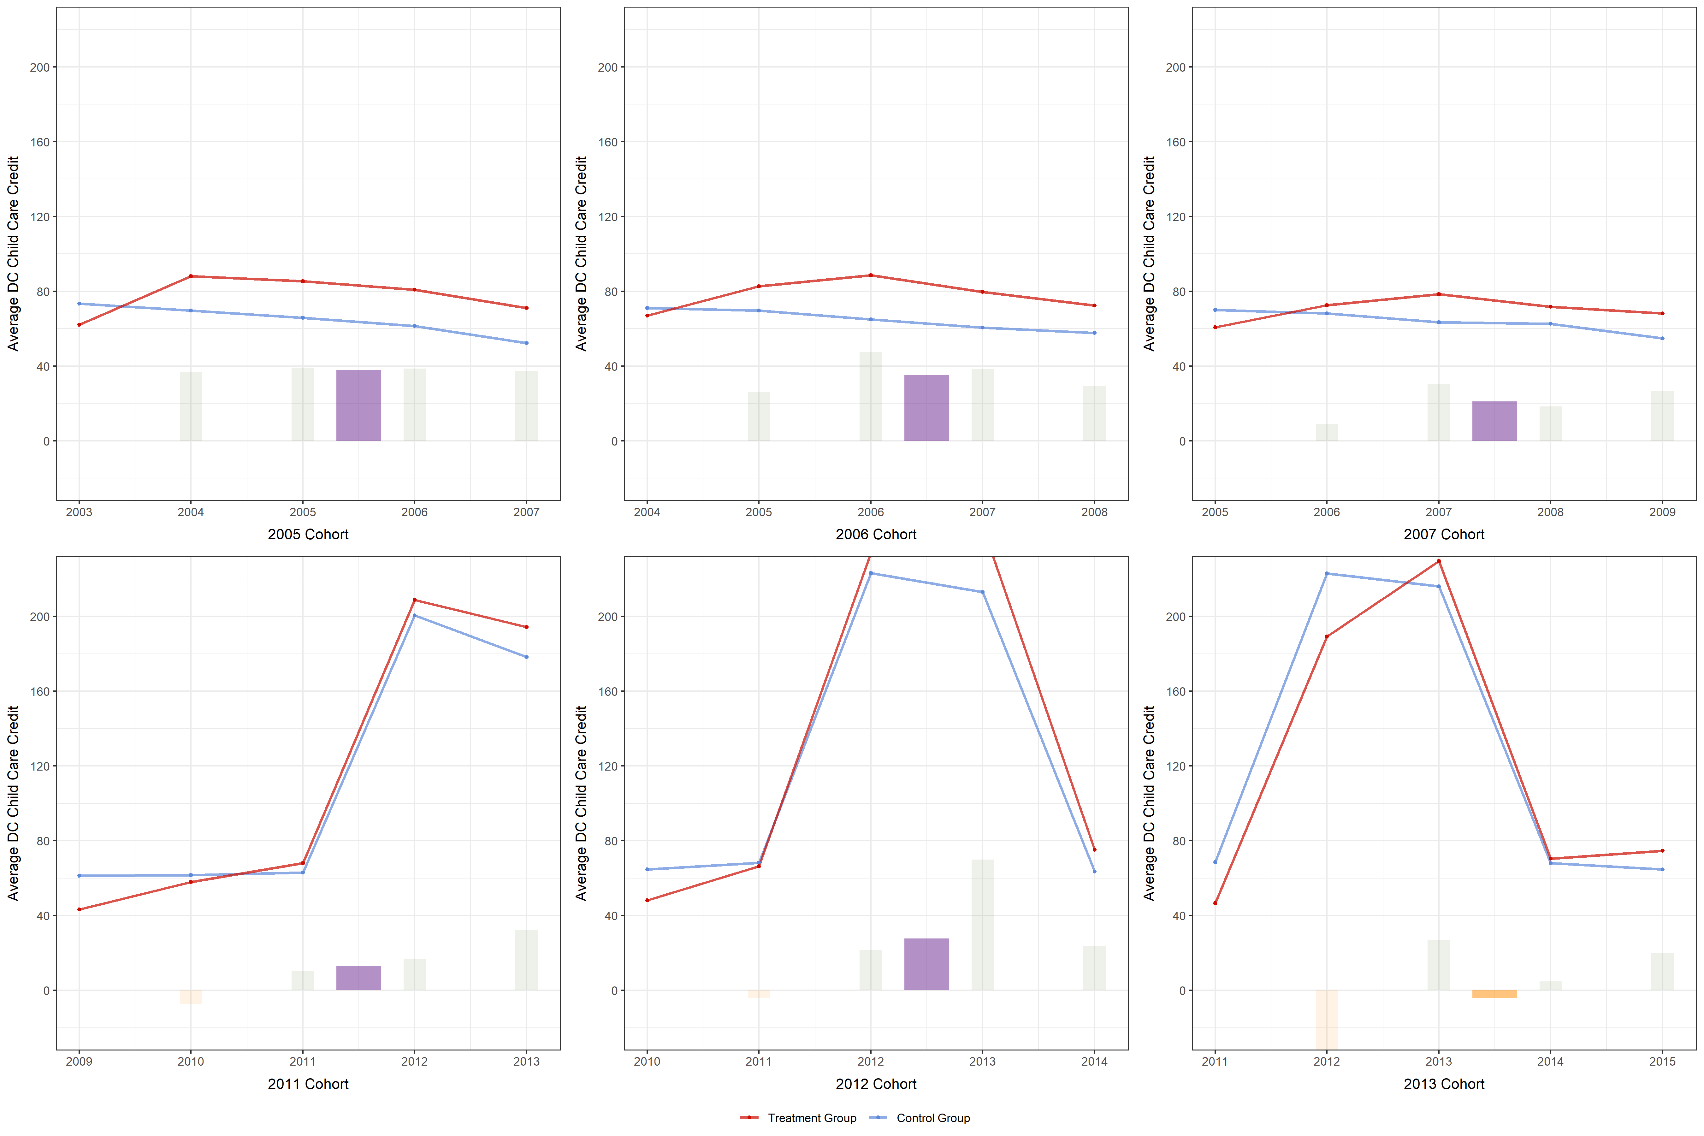
■ Child Care Credit Trends (Actual Level)
Filter
NONE
Cohort | Treatment | Control
2005 | 860 | 3,179
2006 | 829 | 3,322
2007 | 1,055 | 4,025
Cohort | Treatment | Control
2011 | 1,511 | 3,768
2012 | 1,390 | 3,835
2013 | 1,459 | 4,143

Slide 20
■ Analysis
Subset Options
Types (filling status) ① All ② Married ③ Head of Household
Income threshold ① NA ② top 70% ③ bottom 30%
By Ward: singly and jointly
Spoiler…
Types X Inc : [HoH × NA] [HoH × b30] [MAR × NA] [MAR × b30]
Ward : [1+4 × b30]

Slide 21
Results
■ Results
Interesting results from the set of analyses

Slide 22
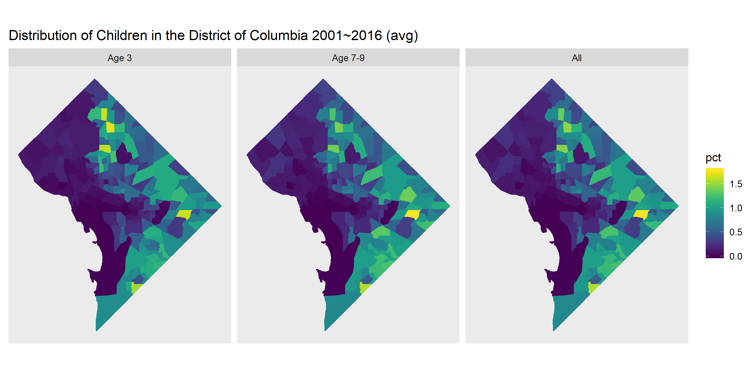
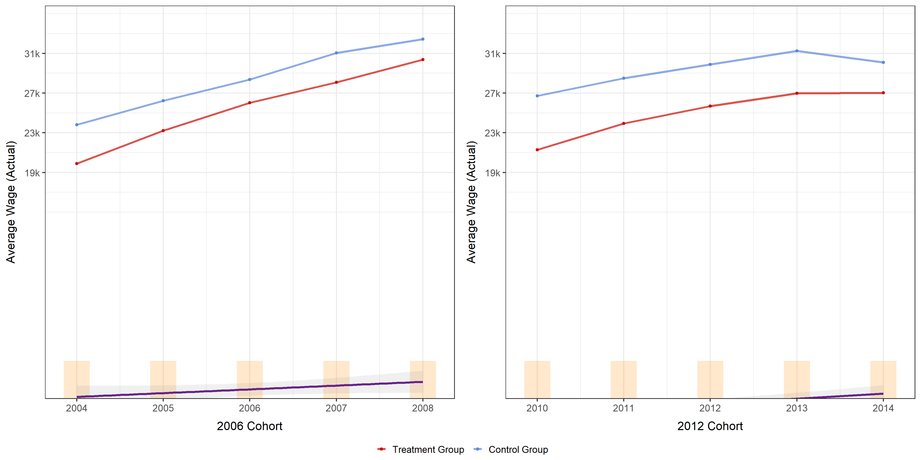
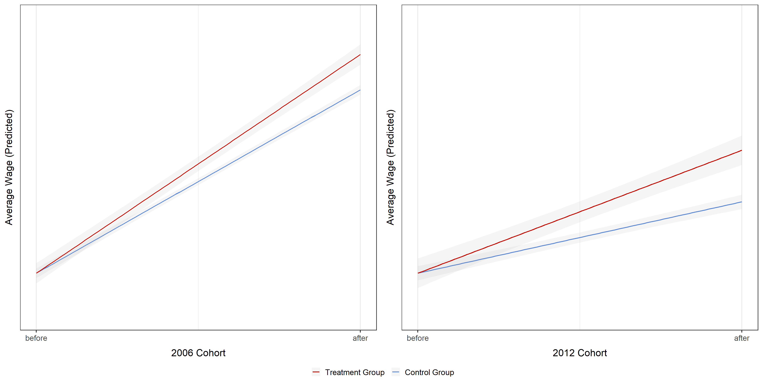
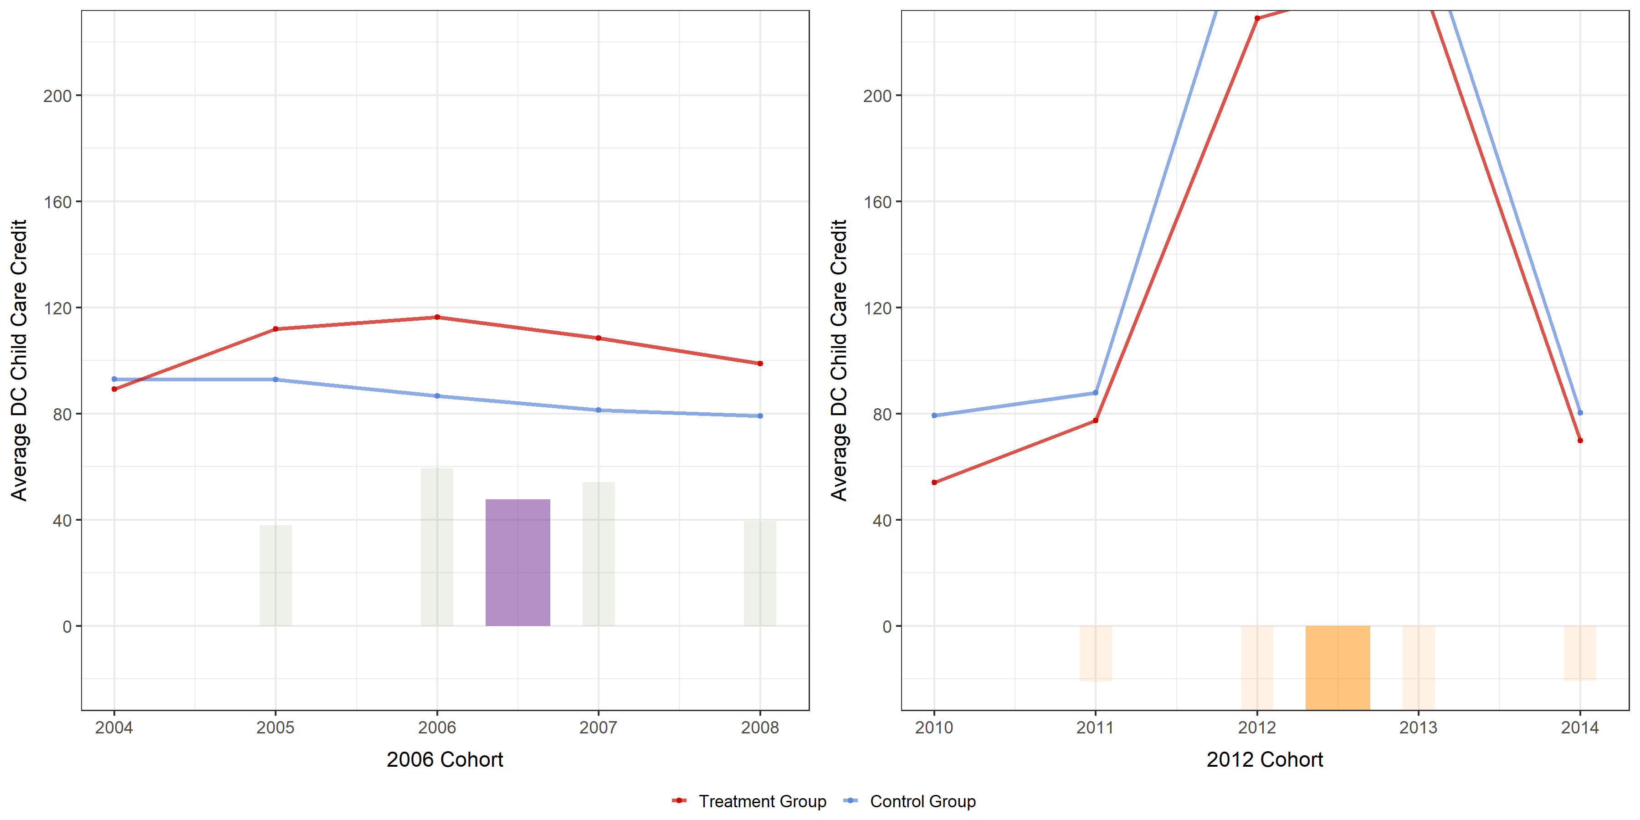
■ HoH : NO behavioral change empirically found
Filter
HoH × NA
■ Population Distribution
■ Average Wage Trend
■ DiD Regression Plot
■ Childcare Credit (Claimed) Trend
left 1672, right 2440

Slide 23
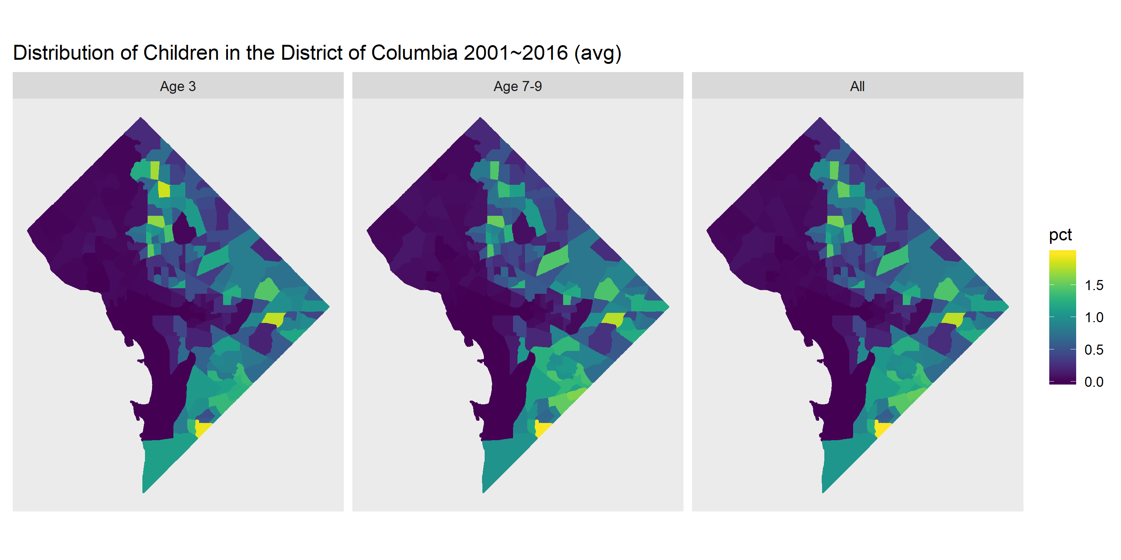
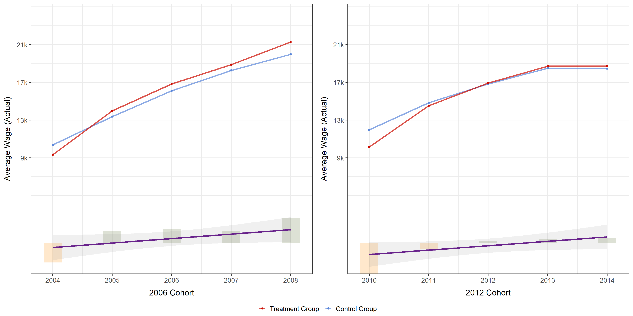

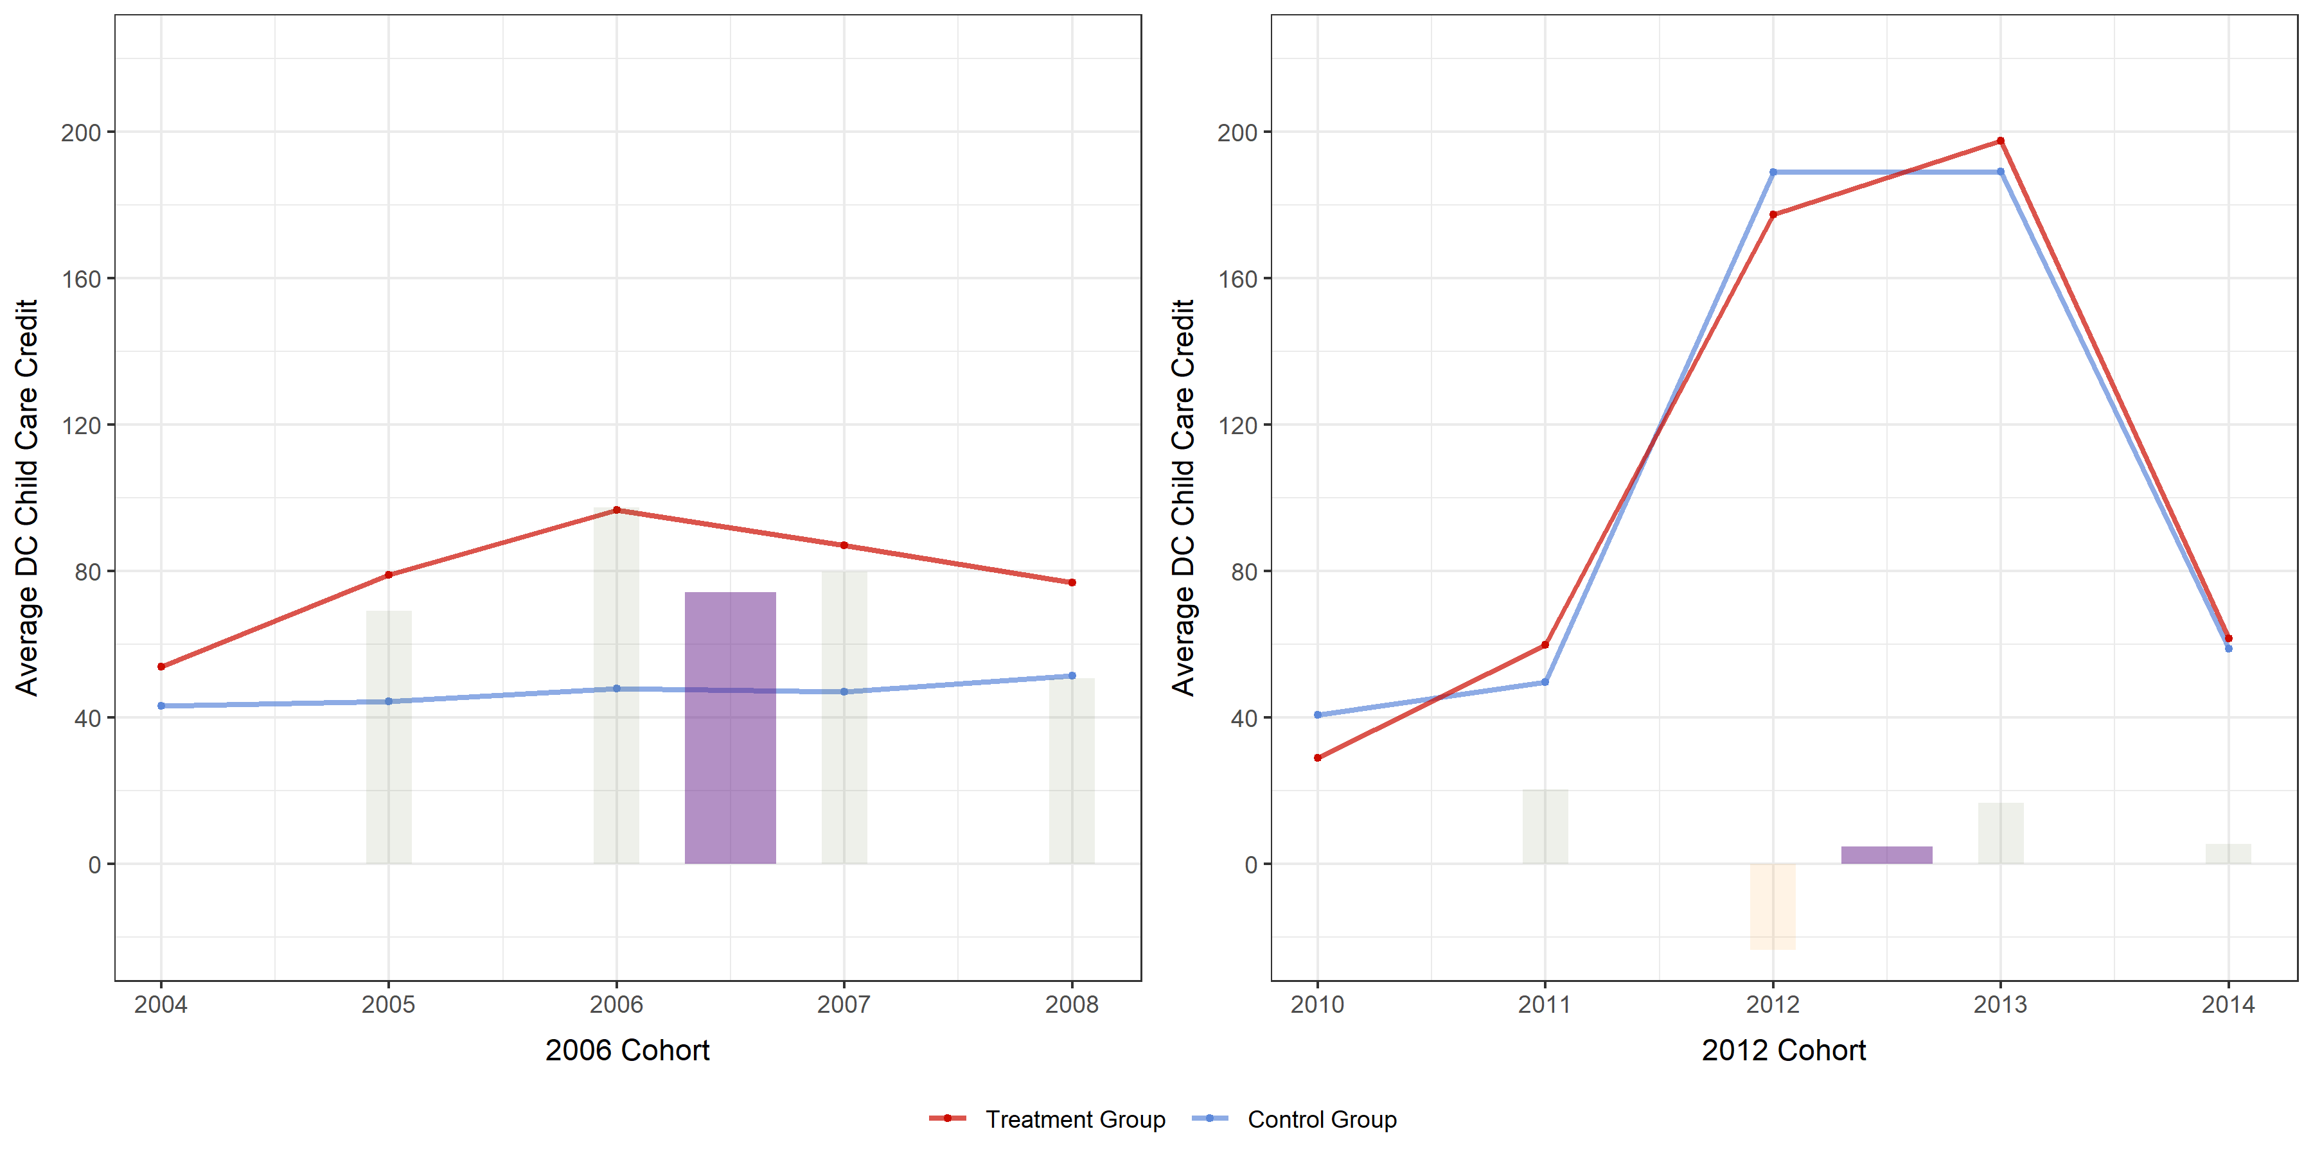
■ HoH : NO behavioral change empirically found
Filter
HoH × b30
■ Population Distribution
■ Average Wage Trend
■ DiD Regression Plot
■ Childcare Credit (Claimed) Trend
left 1959, right 2333

Slide 24
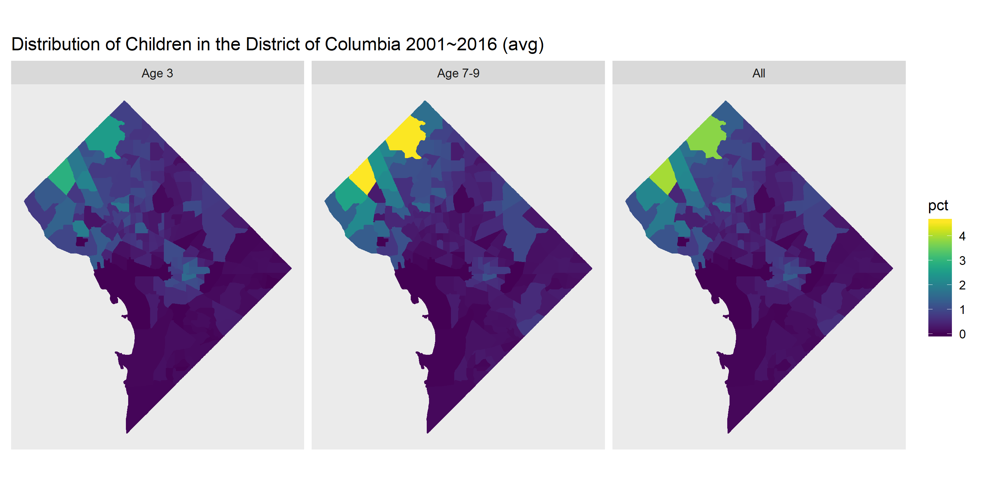
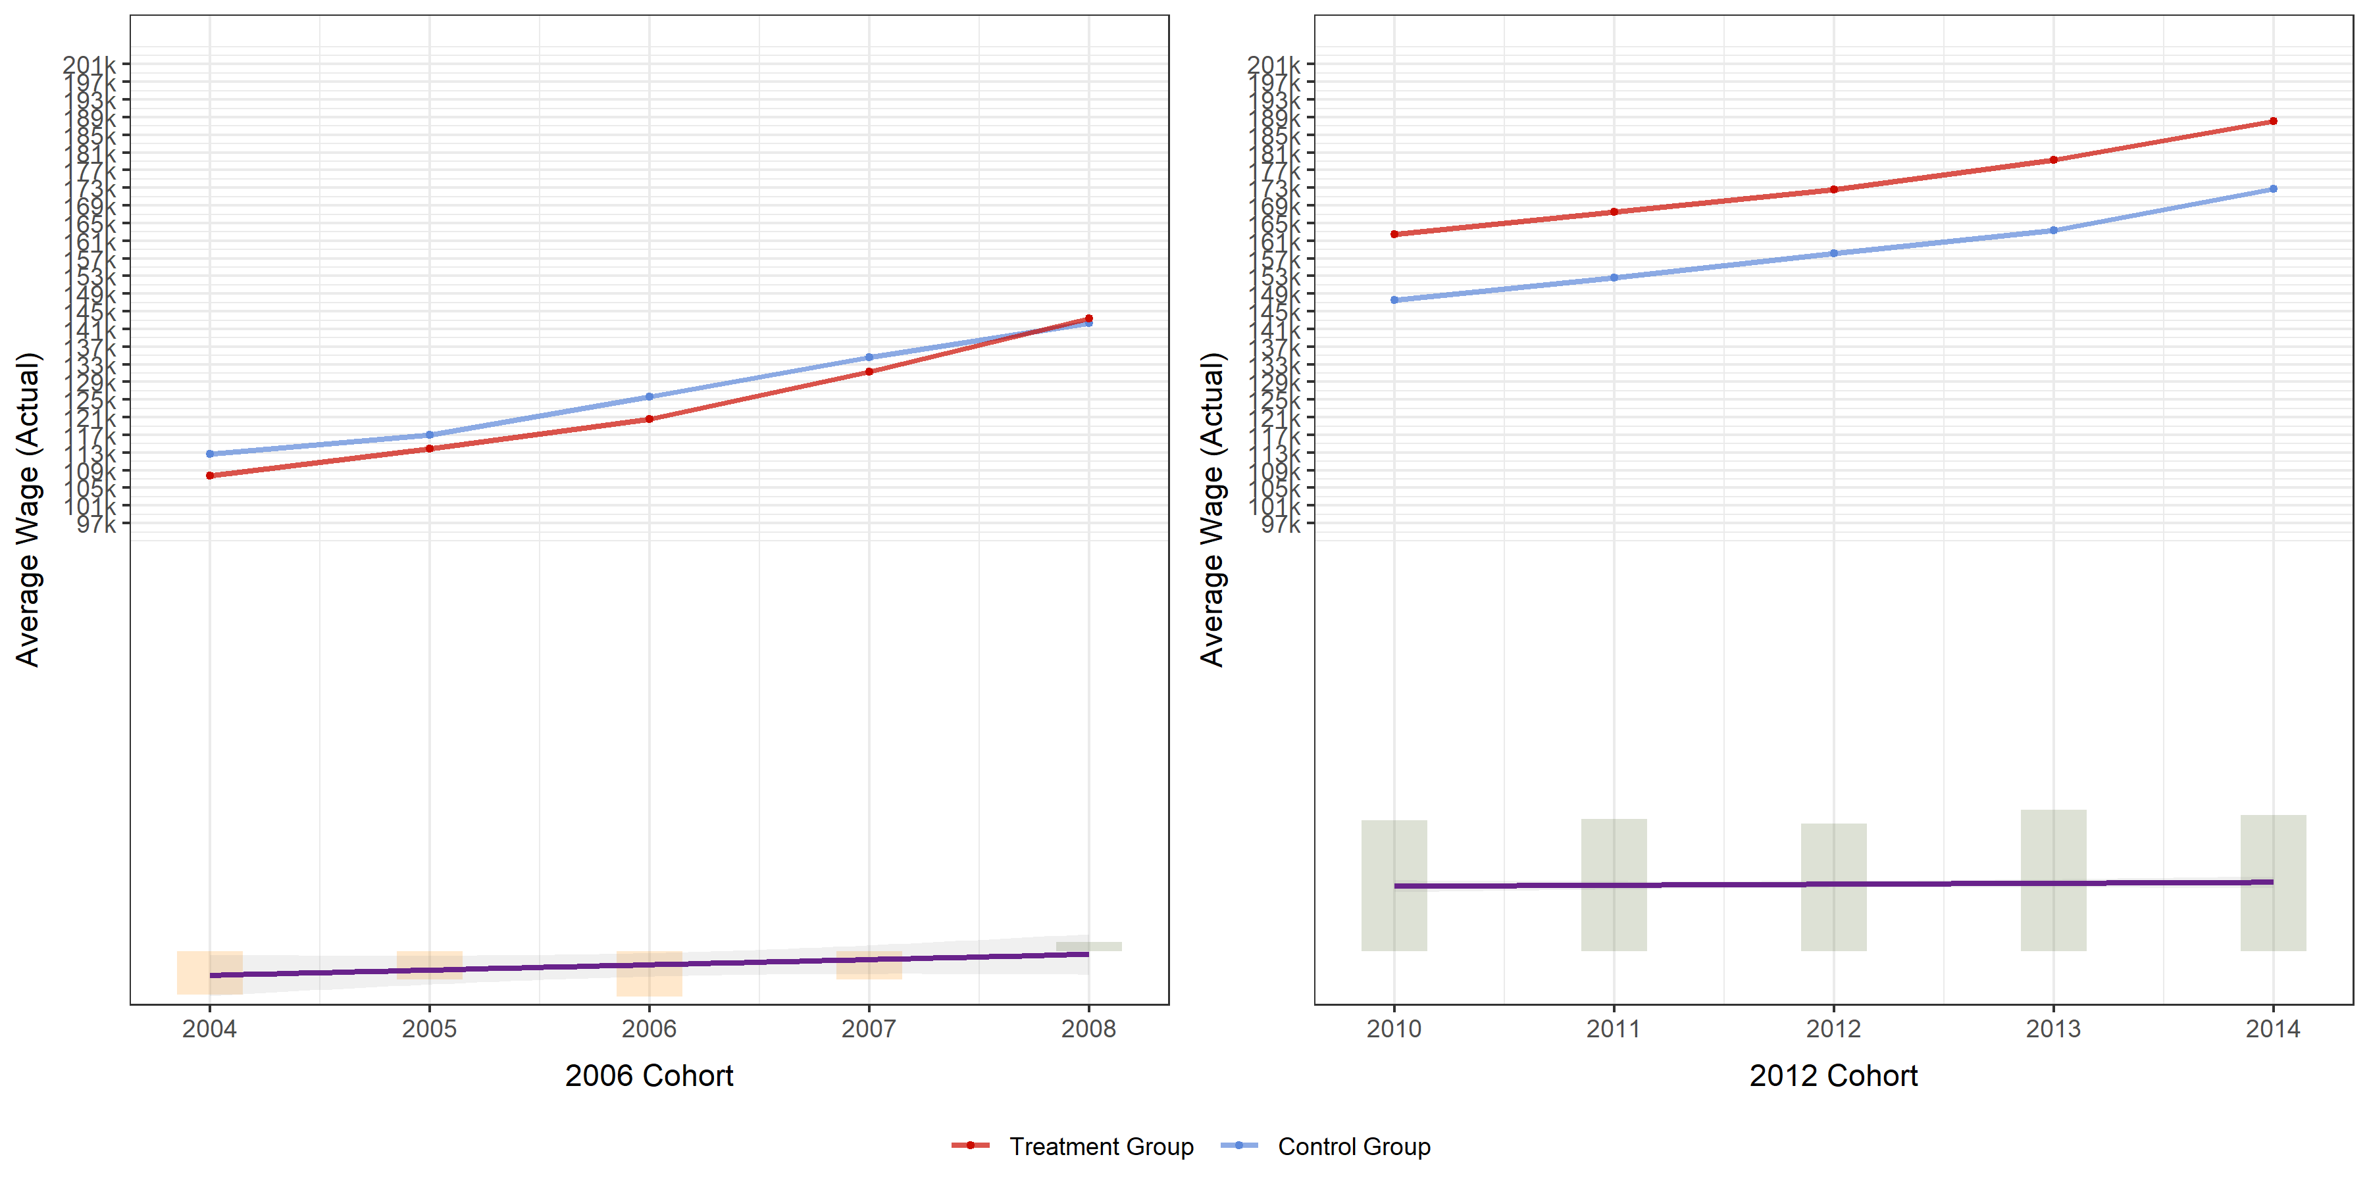
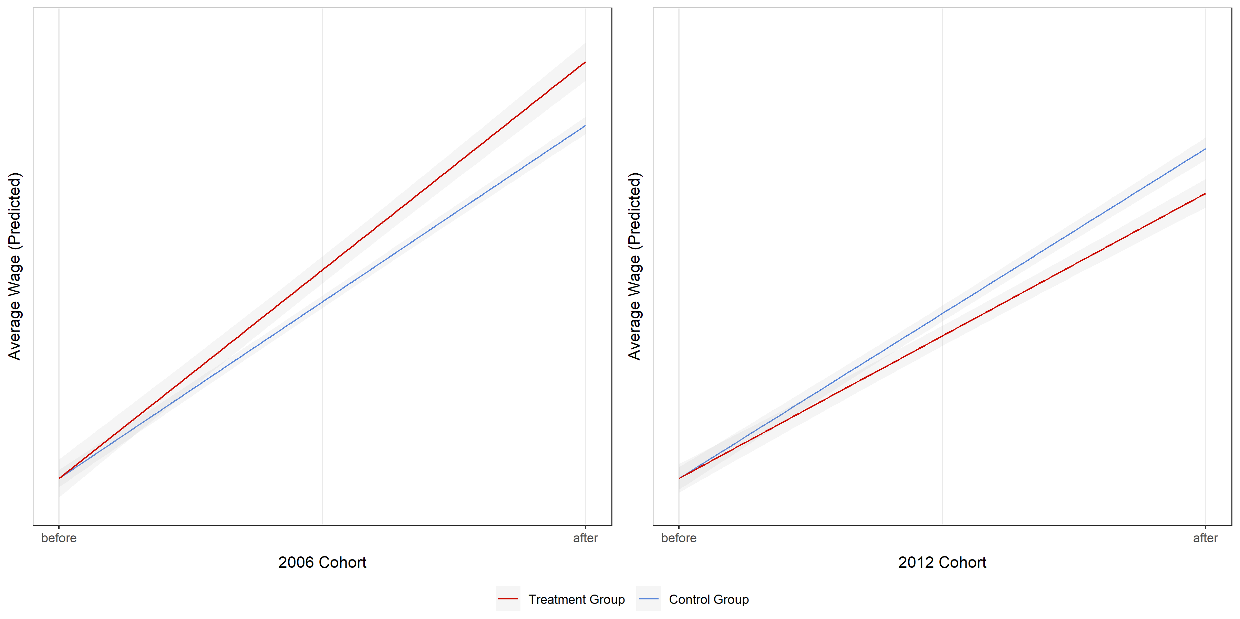
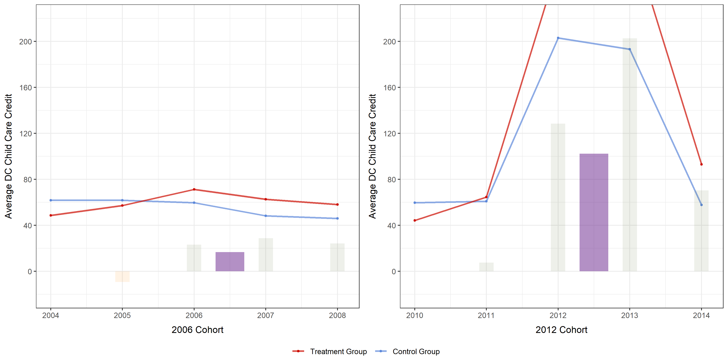
■ MAR : suspect behavioral change?
Filter
MAR × NA
■ Population Distribution
■ Average Wage Trend
■ DiD Regression Plot
■ Childcare Credit (Claimed) Trend
left 5412, right -3798

Slide 25
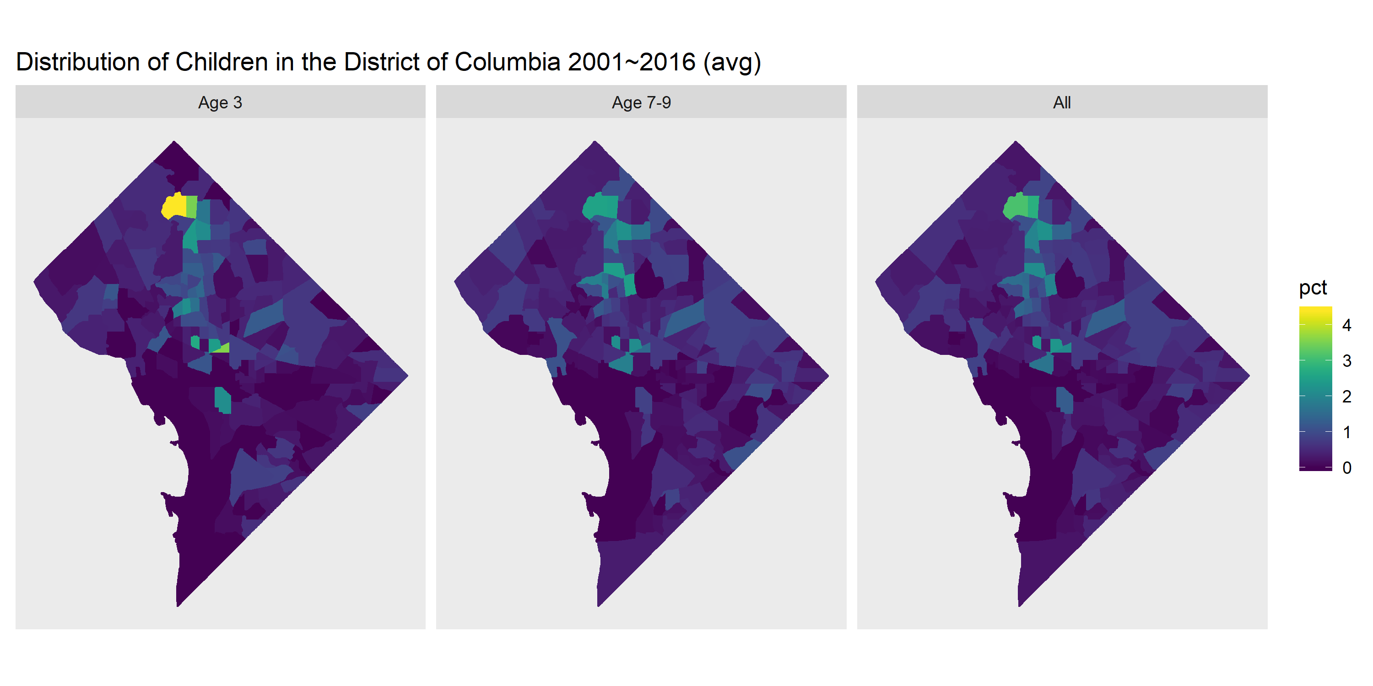
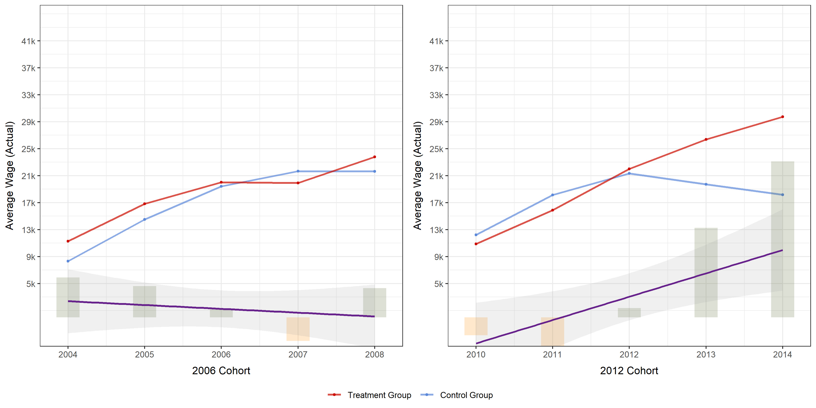
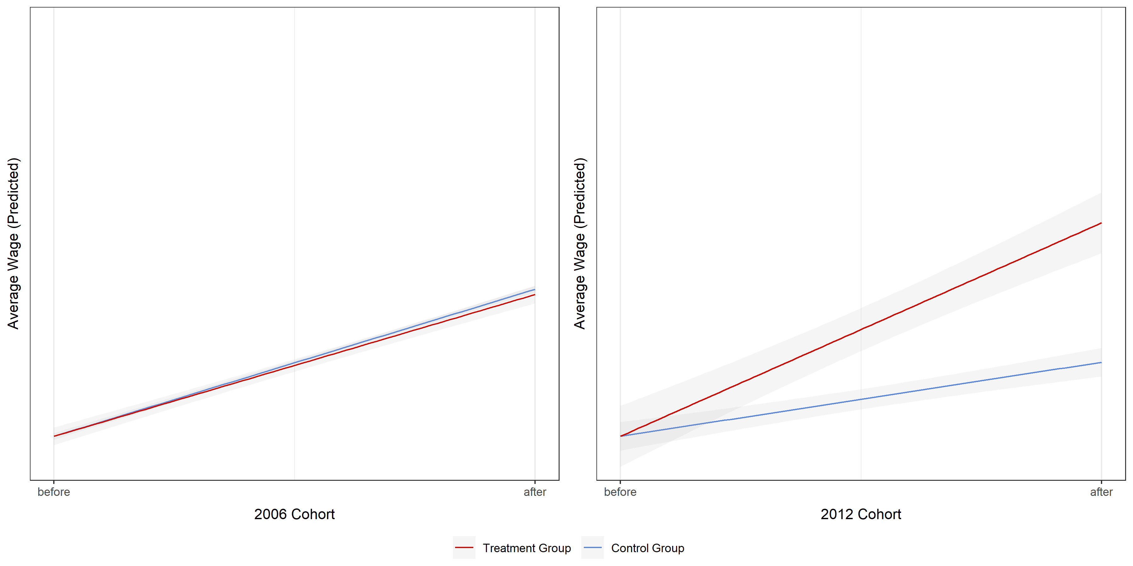
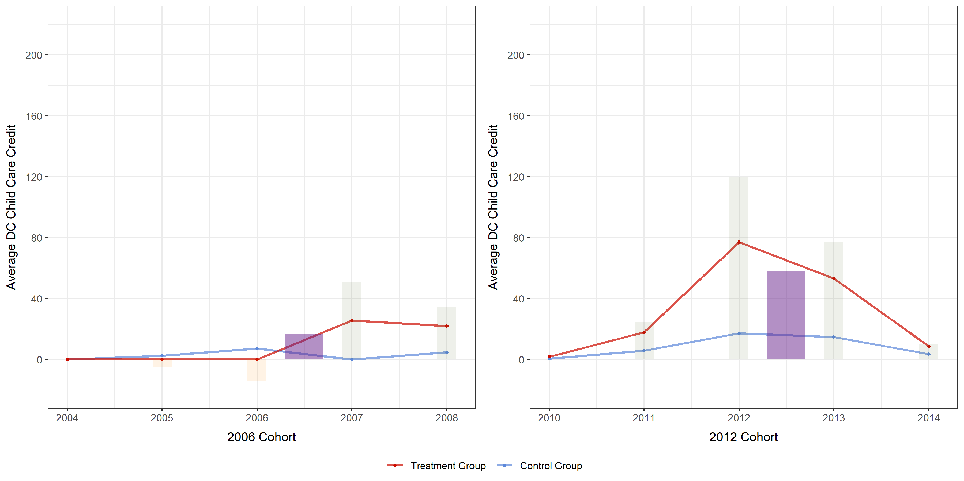
■ MAR : behavioral change empirically found!
Filter
MAR × b30
■ Population Distribution
■ Average Wage Trend
■ DiD Regression Plot
■ Childcare Credit (Claimed) Trend
left -468, right 12312

Slide 26
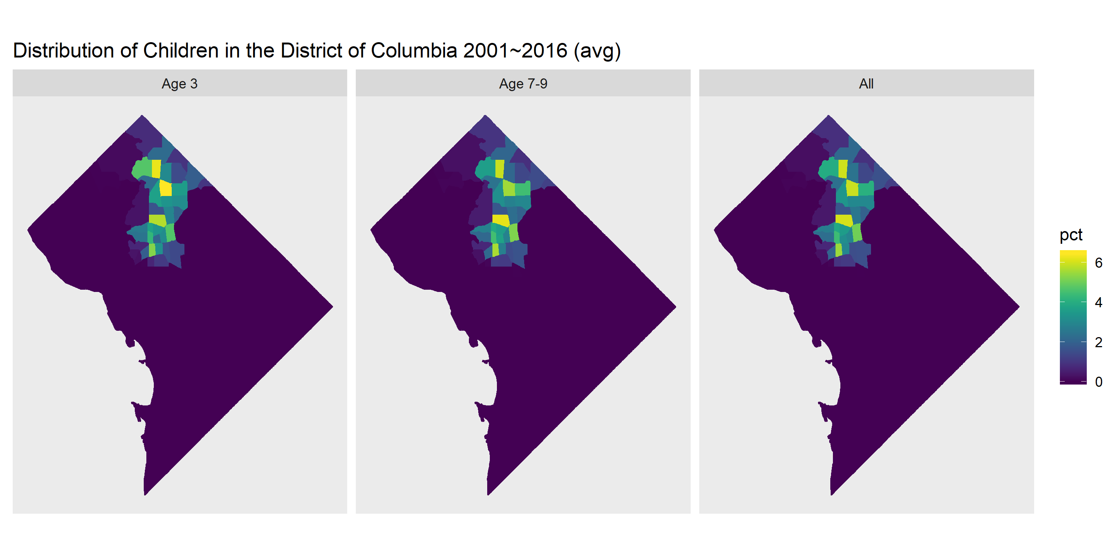
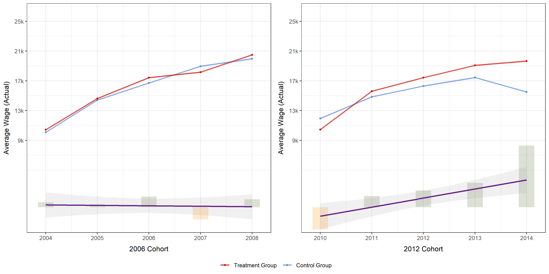
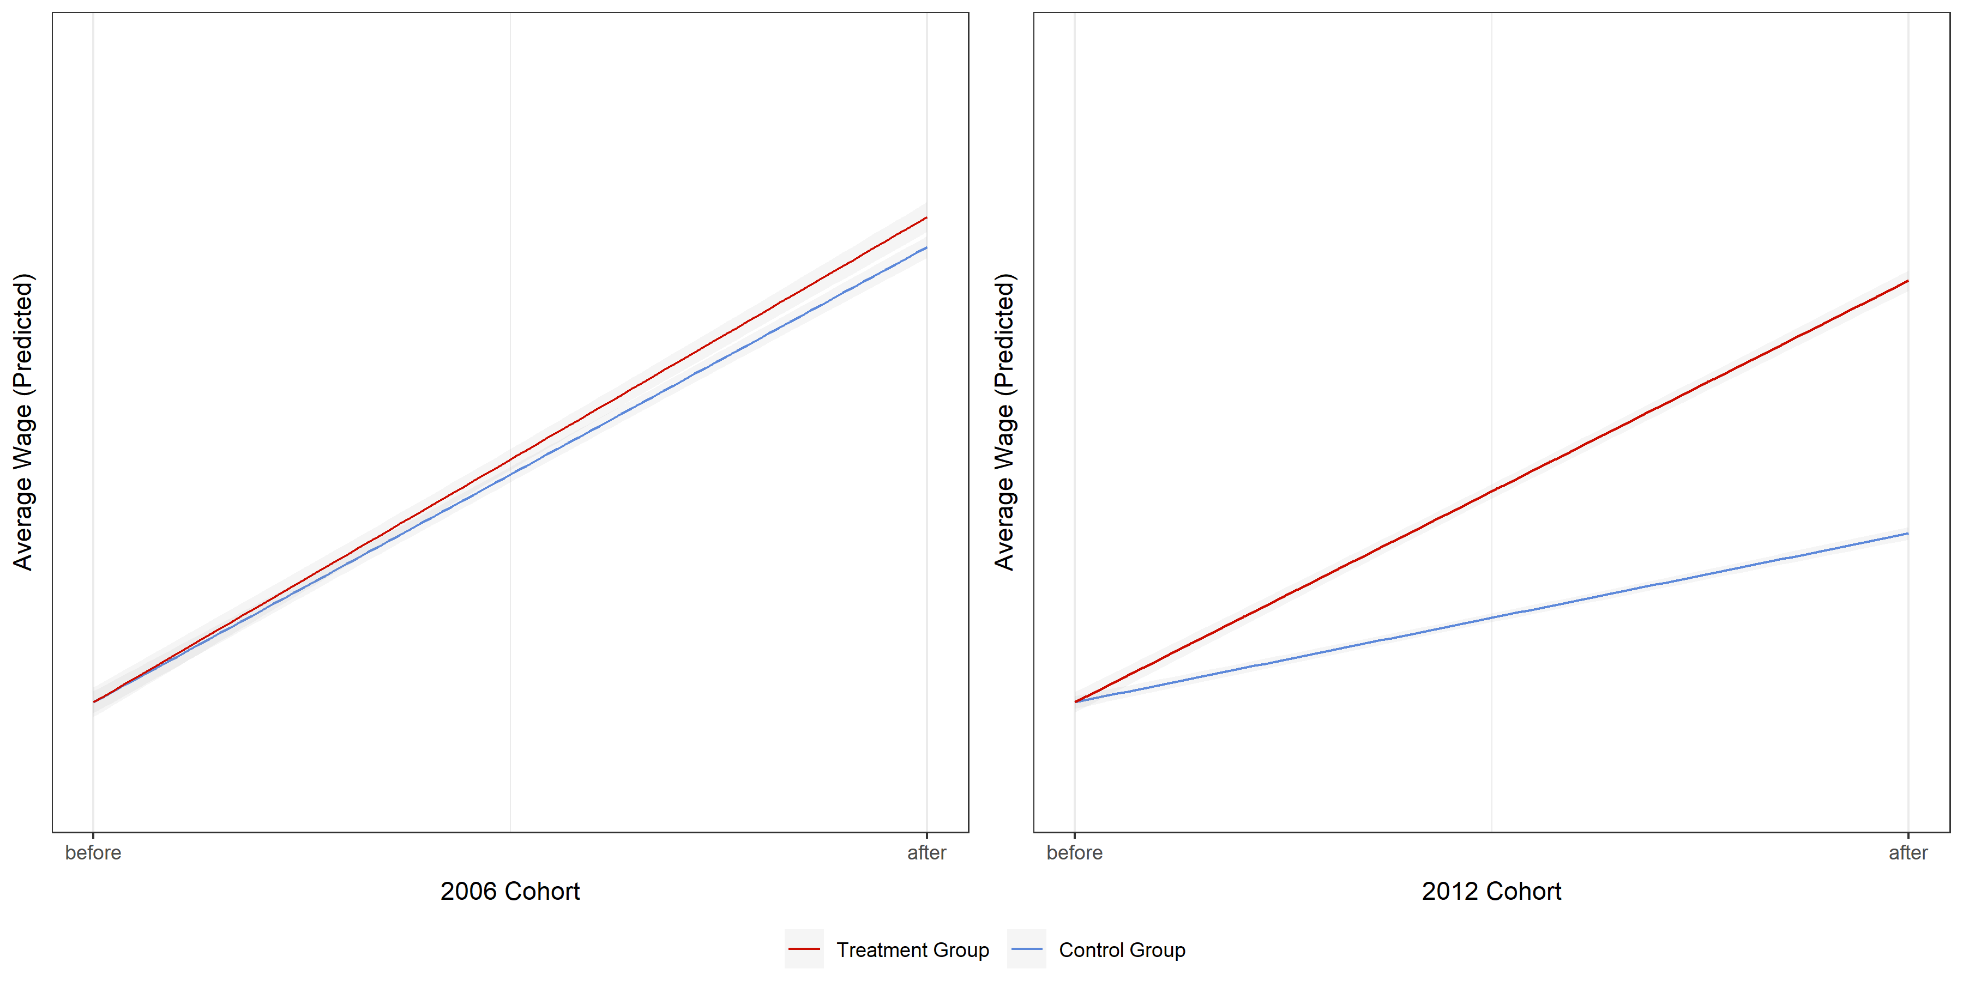
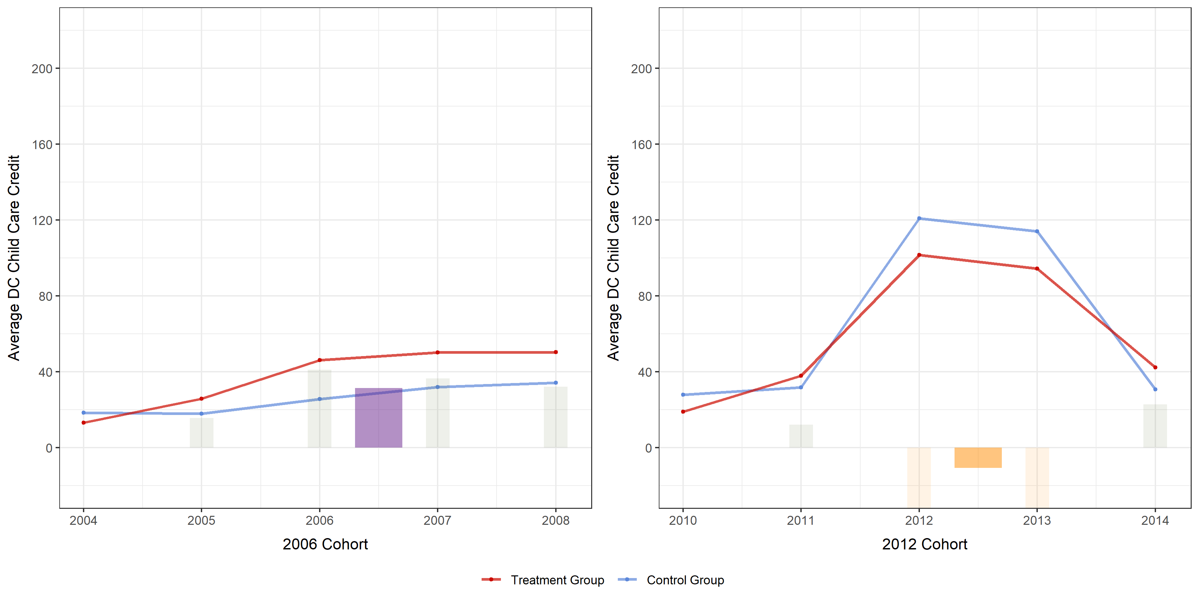
■ Ward 1+4 : behavioral change empirically found!
Filter
W1+4 × b30
■ Population Distribution
■ Average Wage Trend
■ DiD Regression Plot
■ Childcare Credit (Claimed) Trend
left 645, right 5424

Slide 27
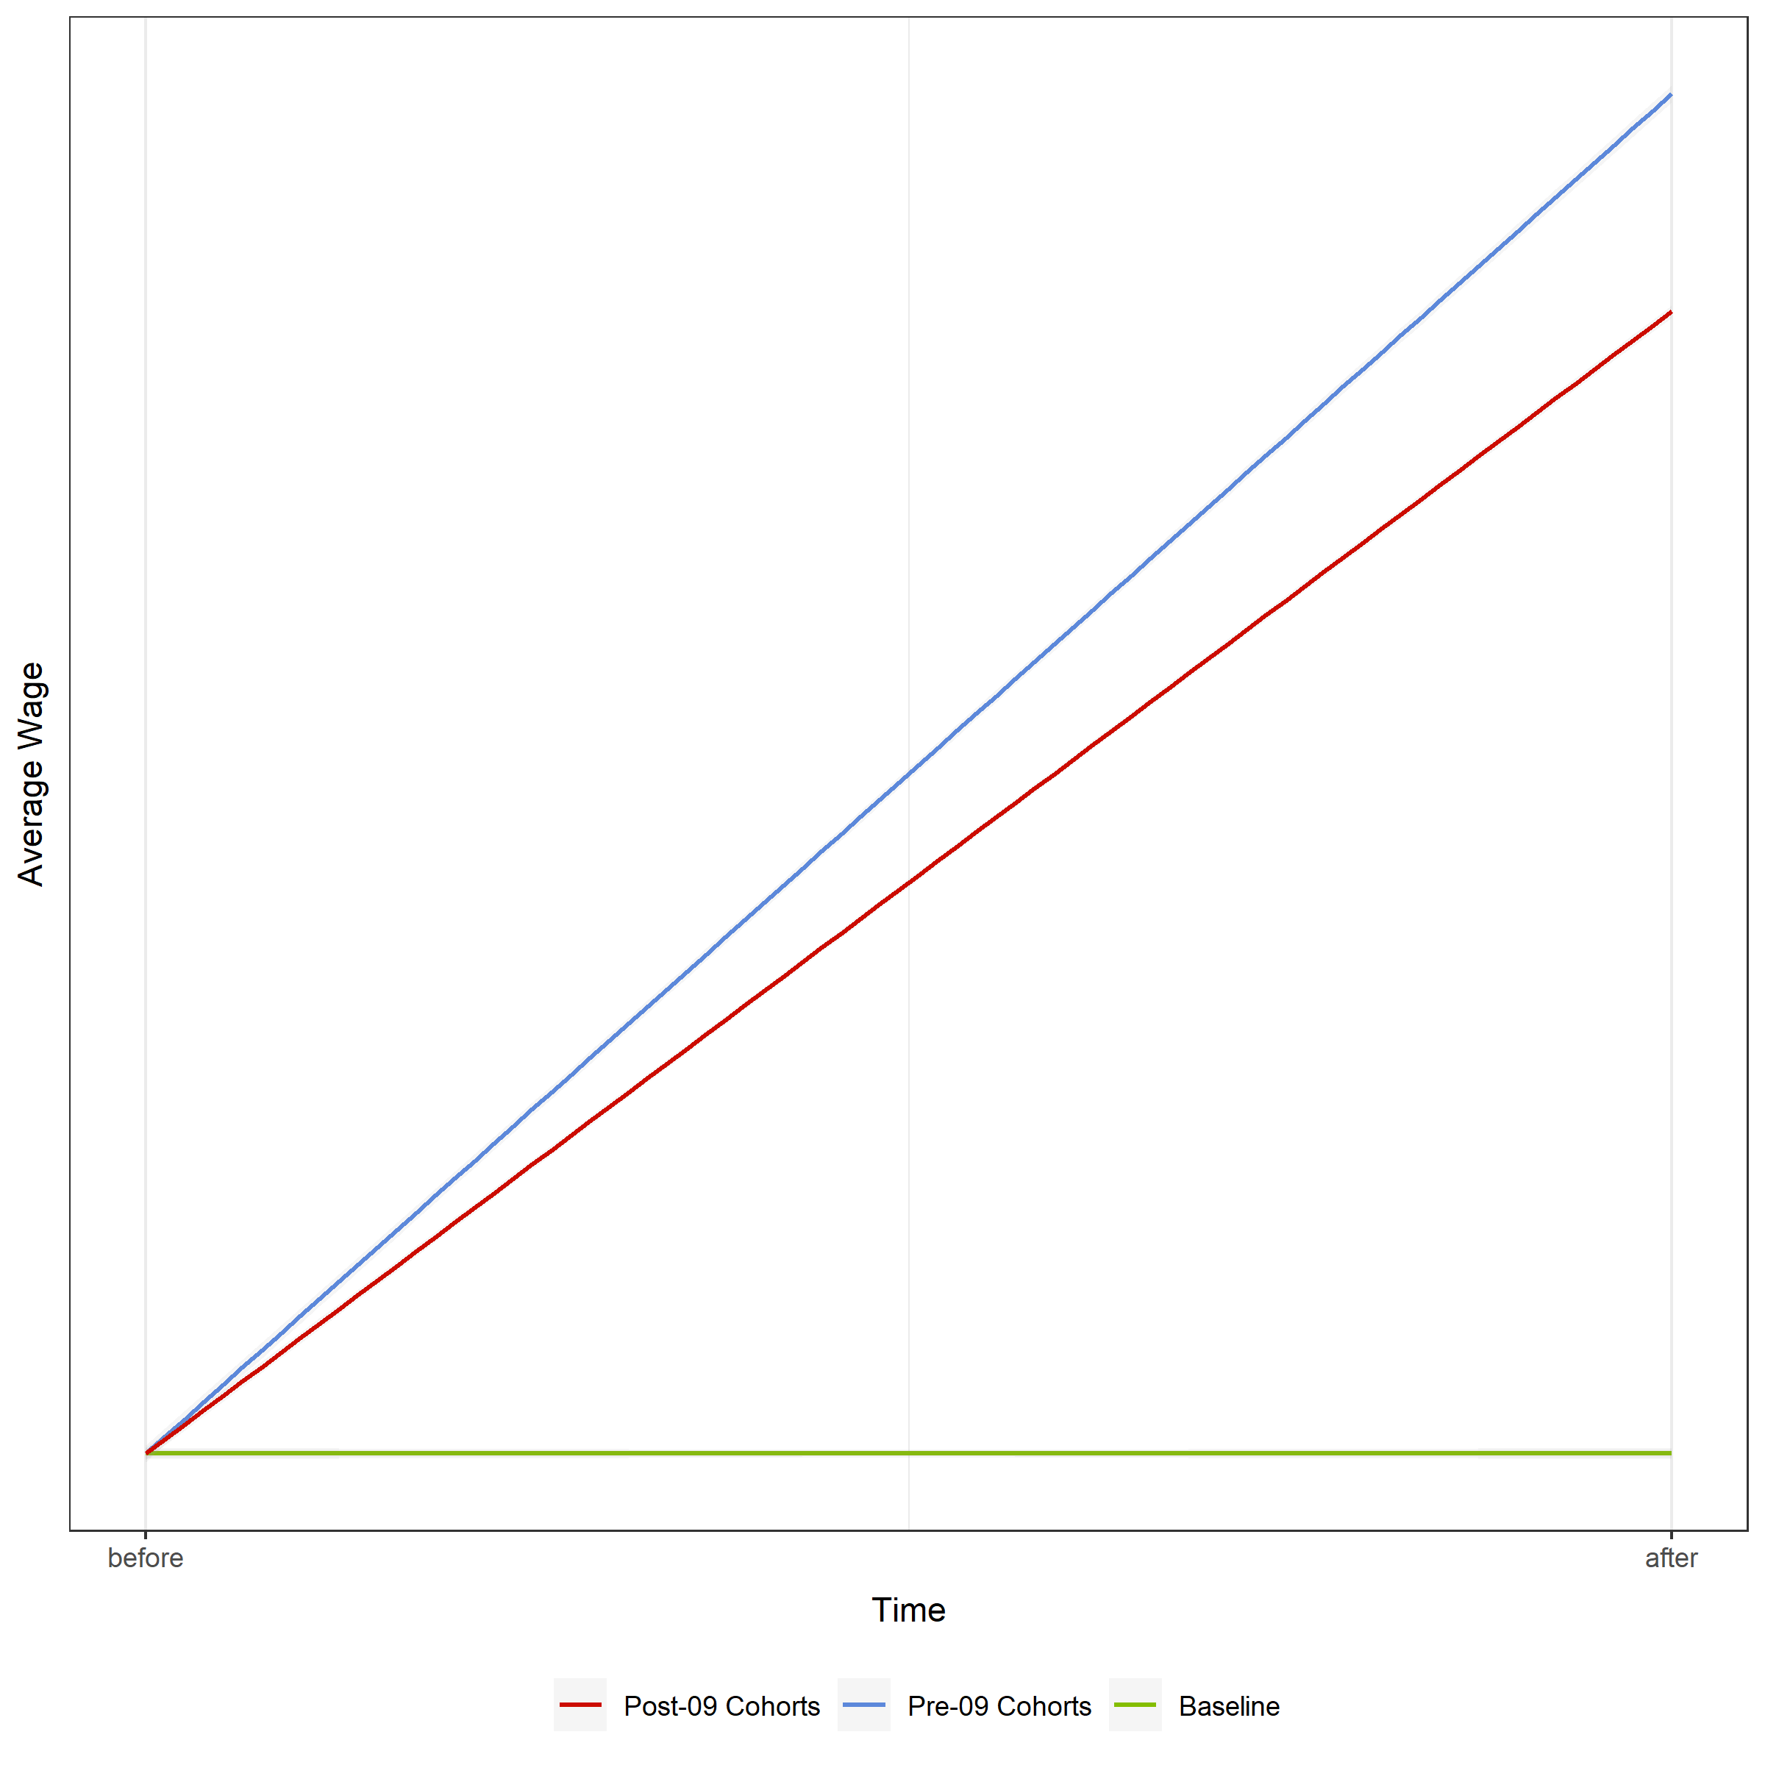
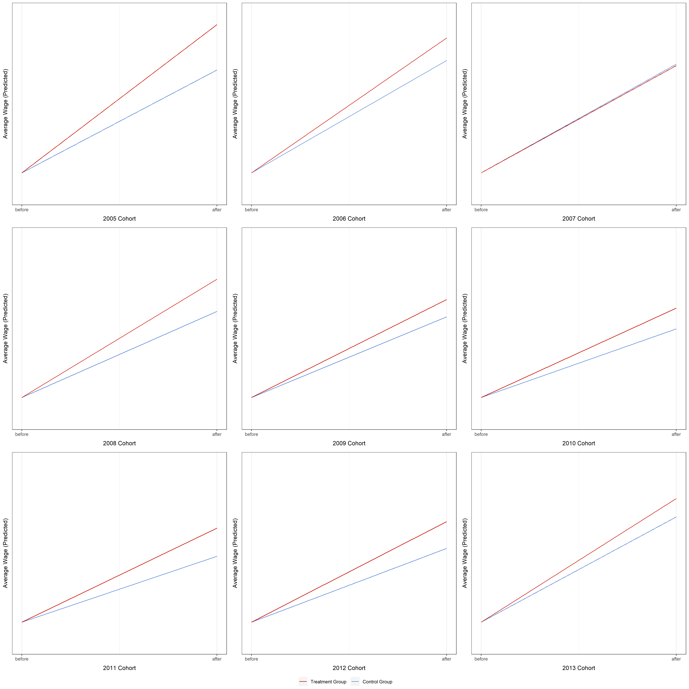
■ HoH : Triple Difference Method (Imperfect)
Filter
HoH × b30
■ Triple Difference Regression Plot
■ DiD Regression Plot
Insignificant

Slide 28
Conclusion
■ Conclusion
Universal Pre-K 3|4

Slide 29
■ Universal Pre-K in DC
Findings 1. We observe no overall effect for the whole population no increase in mean wage level 2. We observe some behavioral change of MAR × b30 population MAR × b30 are going back to the labor force 3. We can infer some welfare improvement for HoH population HoH no longer pays for Pre-K, thus their spending power increase +. The policy appears to set a new norm for MAR population Childcare credit signals that everyone enrolls in Pre-K
Other Dimensions CBA perspective Child Development

Slide 30
■ Universal Pre-K in DC
Conclusion Existing literature finds growth in extensive margin 1. We confirm their findings from the growth in intensive margin 2. We also identified the segment where the growth stems from Married bottom 30% and Ward 1 and Ward 4 3. We conclude that head of household filers enjoy the expense cut HoH claims less childcare credit 4. We believe that the children are in better quality education facility 1) OSSE Report 2) Inference from the mean wage level 5. The new policy, Pre-K 0/1/2 is unlikely to have bigger impact The data suggests that HoH instantly goes back to work

Slide 31
Thank you!
■ The End…

Slide 32
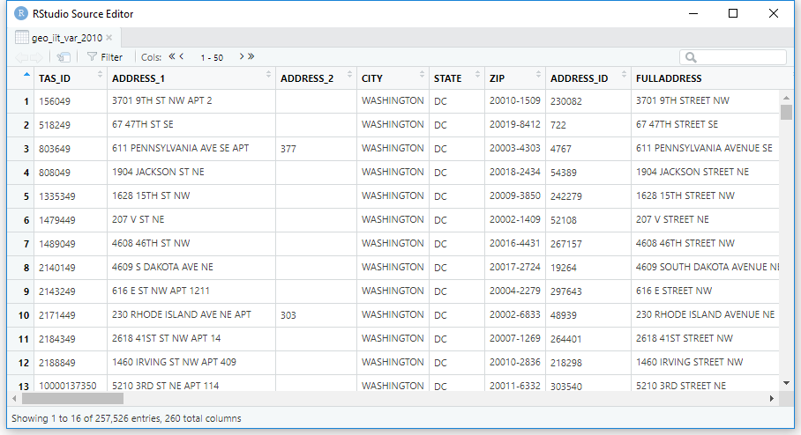
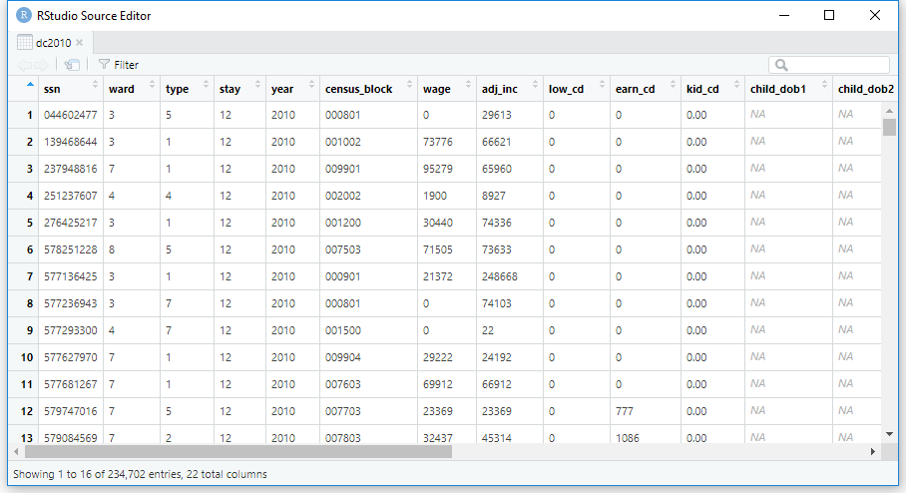
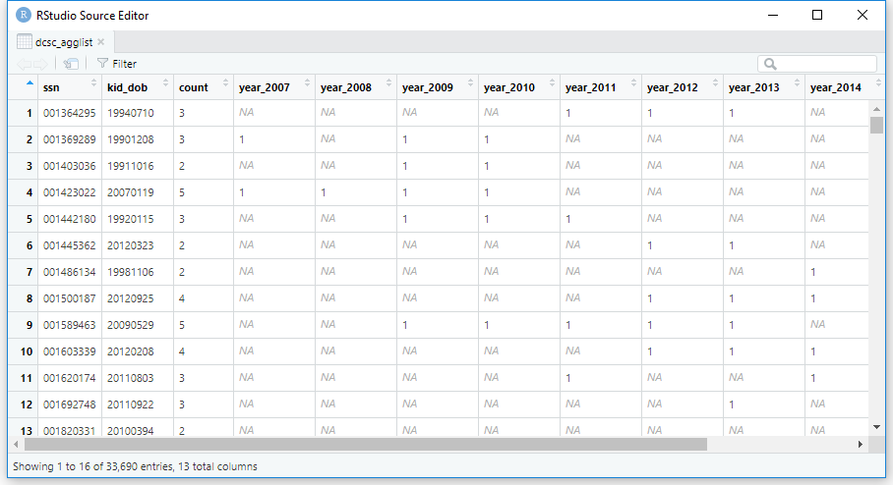
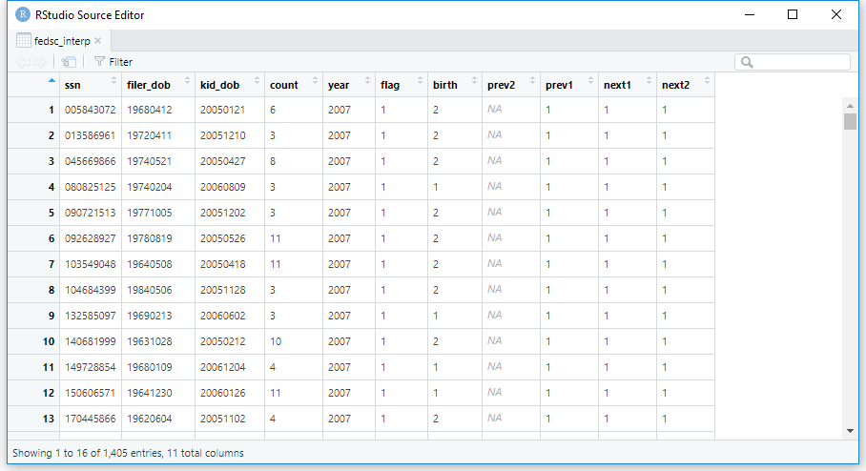
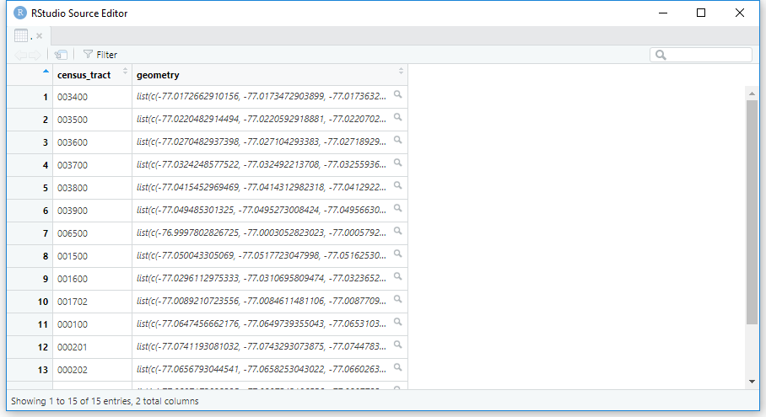
■ Original Data Source: DC IIT
■ Select Interested Variables
■ Single Kid filers
■ Missing Filer Interpolation
■ Census Tracts (DC open data 2010)
■ 5-Year Panel

Slide 33
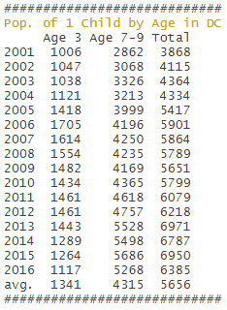
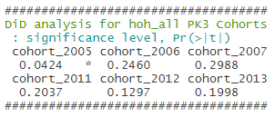
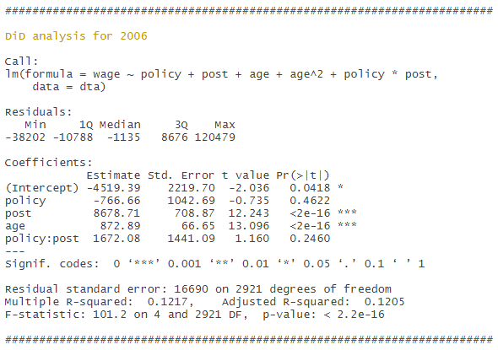

########################
mean 67719, median 33643
mean 96493, median 44141
########################

Slide 34
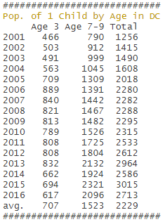
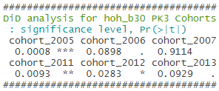
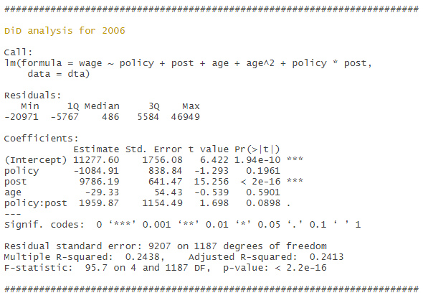
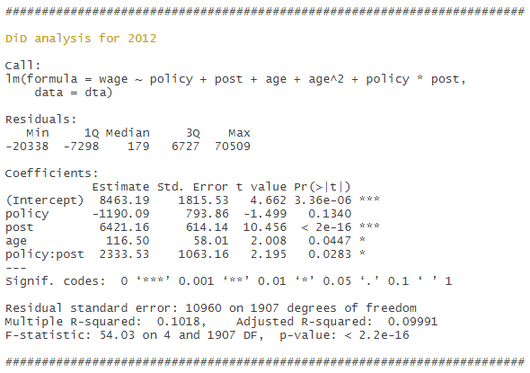
########################
mean 15916, median 14640
mean 15718, median 15116
########################

Slide 35
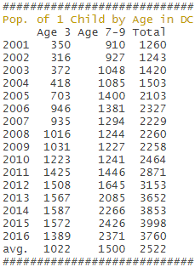
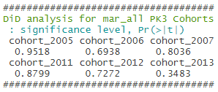


########################
mean 129902, median 101158
mean 167838, median 145832
########################

Slide 36




########################
mean 19649, median 14719
mean 23314, median 19000
########################

Slide 37




########################
mean 15877, median 14638
mean 16099, median 15477
########################

Slide 38


